Slide 1
The Name Game
Look at the names of these childhood games.
Do any of them sound familiar?
Do you think any of them are team games?
Could any of them be played alone?
What equipment might you need?
How energetic do they sound? Give them a score between 0-5
0 1 2 3 4 5
Click on the symbol to hear how they are played….
Use the keyboard arrows to move up or back

Slide 2
Spirit rapping

Slide 3
Spirit rapping
What equipment might you need?
How energetic does it sound? Give it a score between 0-5
0 1 2 3 4 5
Go to the next slide

Slide 4
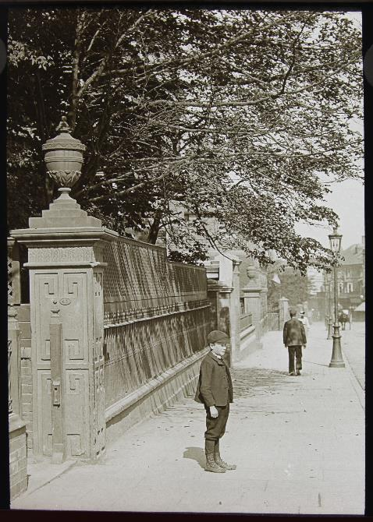
Sound Yer Holler

Slide 5
Sound Yer Holler
Do you think this could be a noisy game?
How energetic does it sound? Give it a score between 0-5
0 1 2 3 4 5
Go to the next slide

Slide 6
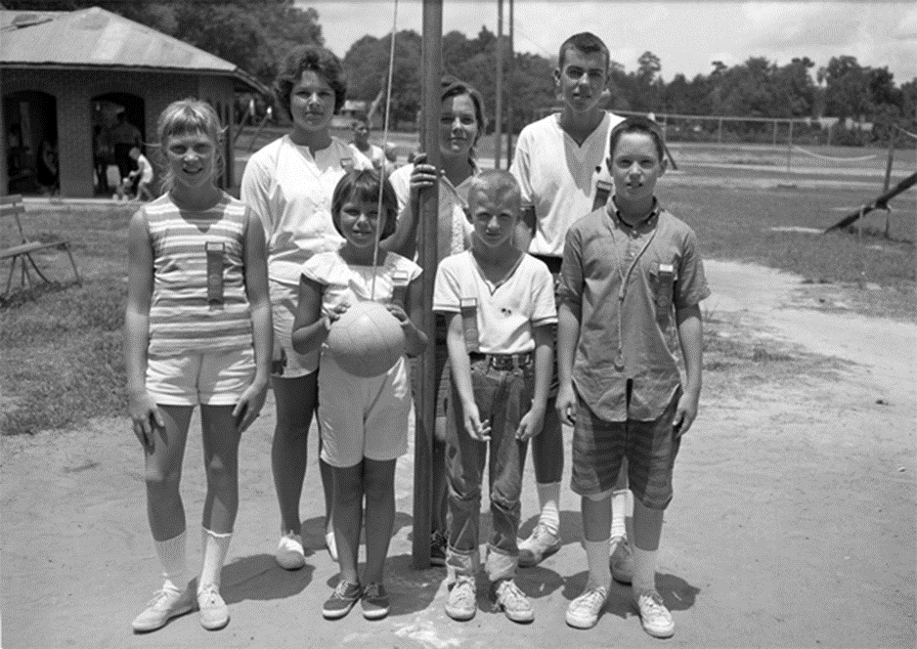
Tetherball

Slide 7
Tetherball
What equipment might you need?
How energetic does it sound? Give it a score between 0-5
0 1 2 3 4 5
Go to the next slide

Slide 8
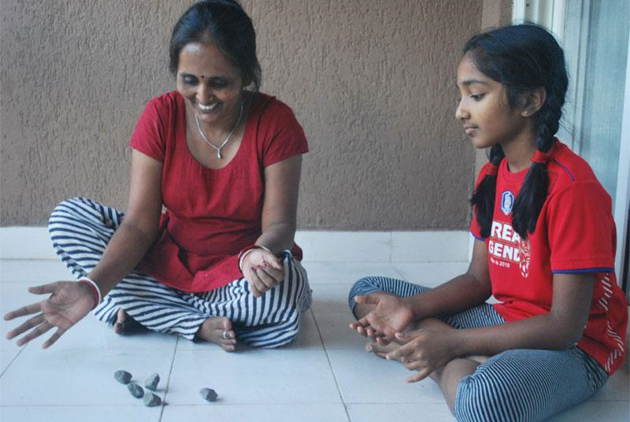
Pacheta

Slide 9
Pacheta
Could this be played on your own?
How energetic does it sound? Give it a score between 0-5
0 1 2 3 4 5
Go to the next slide

Slide 10
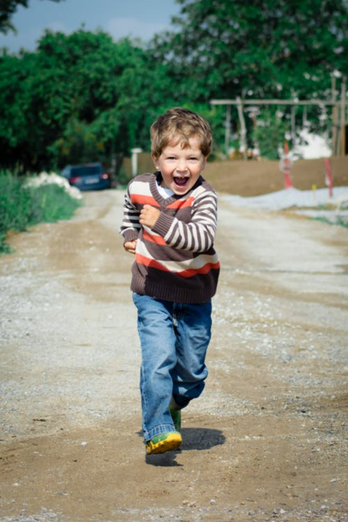
Poddy 1-2-3

Slide 11
Poddy 1-2-3
Could this be a team game?
How energetic does it sound? Give it a score between 0-5
0 1 2 3 4 5
Go to the next slide

Slide 12
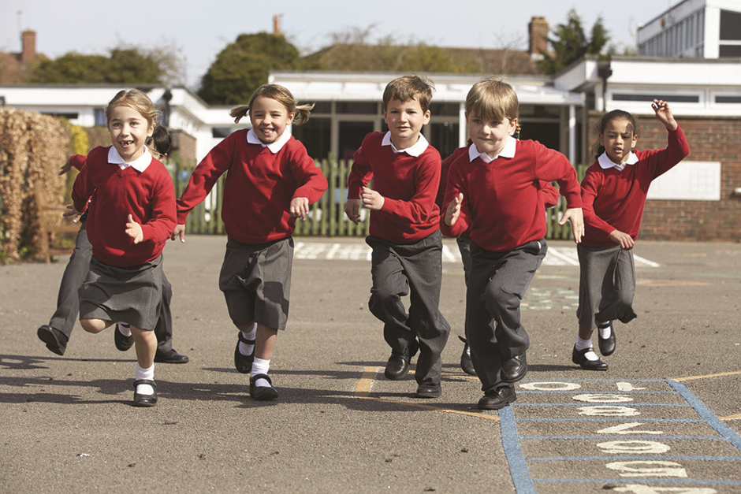
Foggy
Hounds

Slide 13
Foggy Hounds
Do you think there might be some running around?
How energetic does it sound? Give it a score between 0-5
0 1 2 3 4 5
Go to the next slide

Slide 14
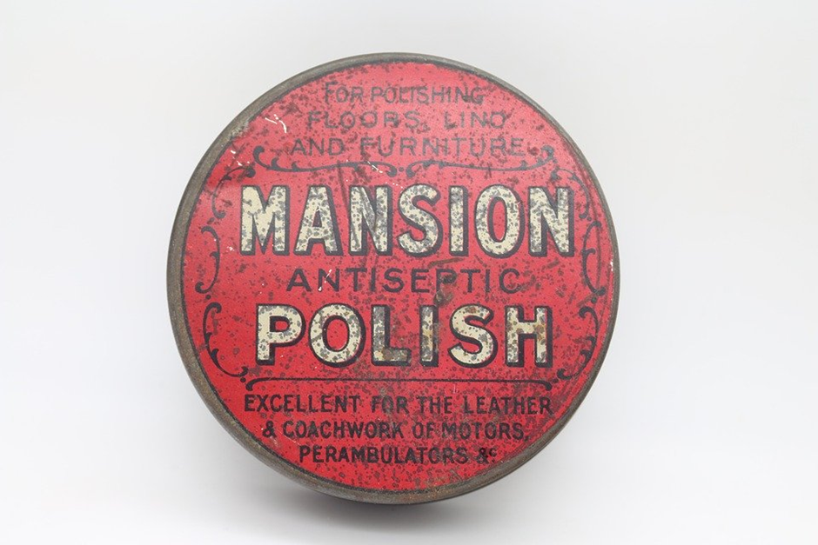
Tin High
Hockey

Slide 15
Tin High Hockey
What equipment might you need?
How energetic does it sound? Give it a score between 0-5
0 1 2 3 4 5
Go to the next slide

Slide 16
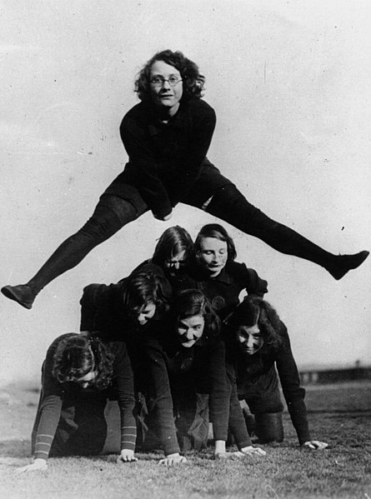
Utchi-Ker-Bum

Slide 17
Utchi-Ker-Bum
Does this sound like a team game?
How energetic does it sound? Give it a score between 0-5
0 1 2 3 4 5
Go to the next slide

Slide 18
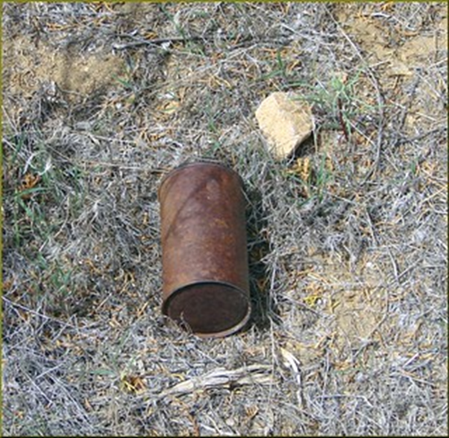
Tin-a-lurky

Slide 19
Tin-a-lurky
What equipment might you need?
How energetic does it sound? Give it a score between 0-5
0 1 2 3 4 5
Go to the next slide

Slide 20
Had you ever heard of these games?
Which was your favourite name?
Which game was the most energetic?
Which game was the least energetic?
Did you play any similar games when you were a child?
What are the names of the games that you played?

Slide 21
Unlocking Our Sound Heritage
“Sound collections are under threat, both from physical degradation, and as the means of playing such sounds disappear from production. Professional consensus internationally is that we have approximately 15 years in which to save many of our sound collections through digitisation, before they become unreadable and are effectively lost.” - Will Prentice, British Library
The University of Leicester is one of ten regional hubs across the UK to join the British Library’s Unlocking Our Sound Heritage project, funded by the Heritage Lottery Fund (HLF). This ambitious project is part of the wider Save Our Sounds programme, which aims to:
Digitally preserve almost half a million rare and at-risk sound recordings
Establish a network of audio preservation centres across the UK
Engage more people with the value of sound recordings

