Slide 1



Slide 2
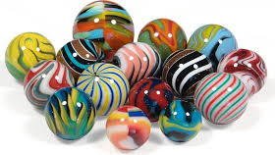
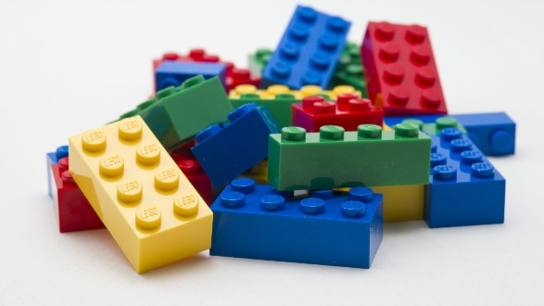
Marbles
Lego bricks

Slide 3
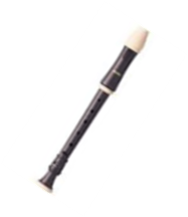
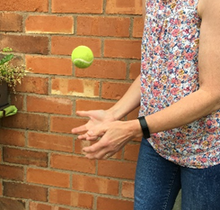

Bouncing ball
Recorder
Duck

Slide 4
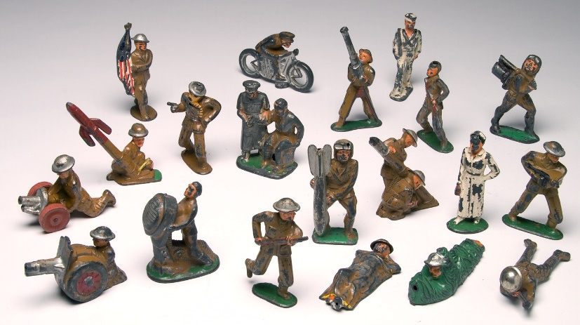
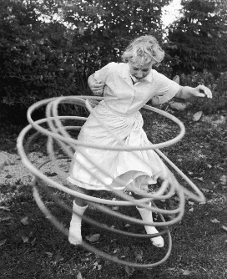
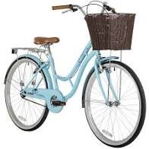
Bike
Toy soldiers
Hoola hoops

Slide 5

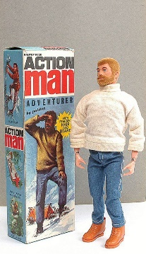
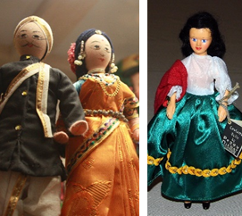
Rosebud doll
Action Man
Dolls from around the world

Slide 6
Living Doll – Cliff Richards 1959
Got myself a cryin', talkin', sleepin', walkin', livin' doll
Got to do my best to please her just 'cause she's a livin' doll
Got a rovin' eye and that is why she satisfies my soul
Got the one and only walkin', talkin', livin' doll

Slide 7
Take a look at her hair, it's real
If you don't believe what I say, just feel
I'm gonna lock her up in a trunk so no big hunk
Can steal her away from me

Slide 8
Got myself a cryin', talkin', sleepin', walkin', livin' doll
Got to do my best to please her just 'cause she's a livin' doll
Got a rovin' eye and that is why she satisfies my soul
Got the one and only walkin', talkin', livin' doll
Guitar solo

Slide 9
Take a look at her hair, it's real
If you don't believe what I say, just feel
I'm gonna lock her up in a trunk so no big hunk
Can steal her away from me

Slide 10
Got myself a cryin', talkin', sleepin', walkin', livin' doll
Got to do my best to please her just 'cause she's a livin' doll
Got a rovin' eye and that is why she satisfies my soul
Got the one and only walkin', talkin', livin' doll.

Slide 11
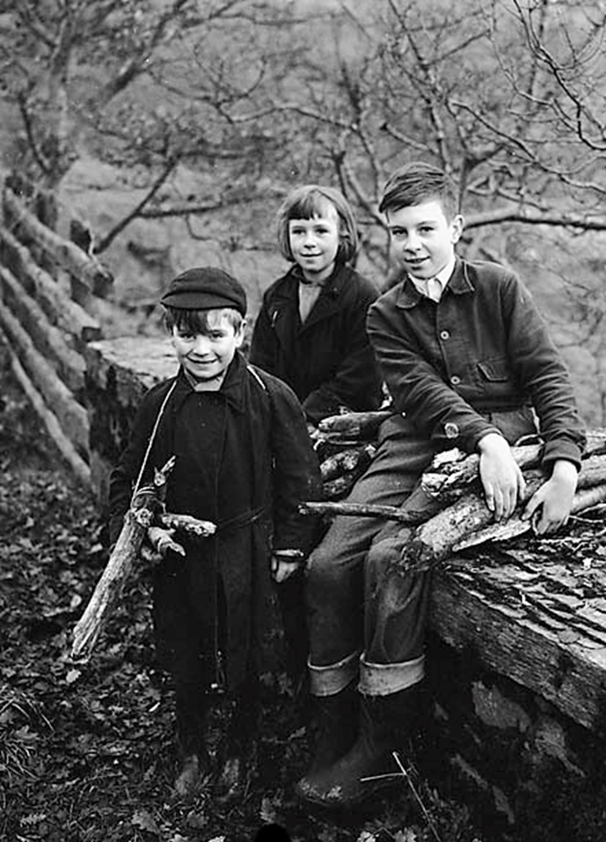
Perilous
Playtimes

Slide 12
Up on the roof – The Drifters 1963
When this old world starts getting me down
And people are just too much for me to face
I climb way up to the top of the stairs
And all my cares just drift right into space
On the roof it's peaceful as can be
And there the world below can't bother me
Let me tell you now

Slide 13
When I come home feeling tired and beat
I go up where the air is fresh and sweet
I get away from the hustling crowds
And all that rat race noise down in the street
On the roof's the only place I know
Where you just have to wish to make it so
Up on the roof
Instrumental

Slide 14
At night the stars put on a show for free
And darling you can share it all with me
I keep-a tellin' you
Right smack dab in the middle of town
I found a Paradise that's trouble-proof
And if this world starts getting you down
There's room enough for two up on the roof
Up on the roof

Slide 15
Simply Sounds…..
Sounds from a summer garden

Slide 16
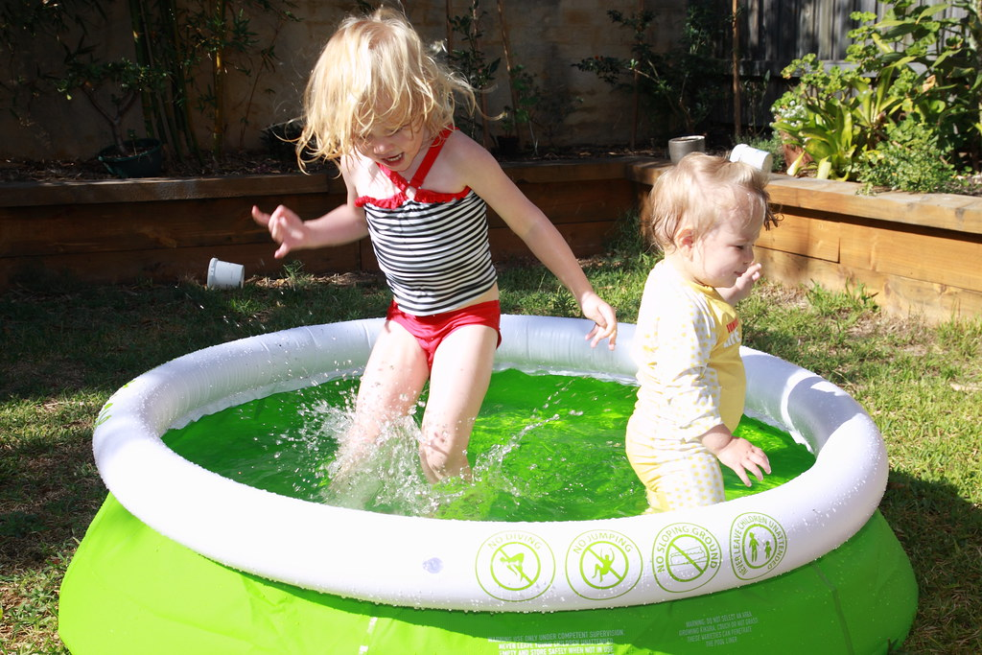

Slide 17
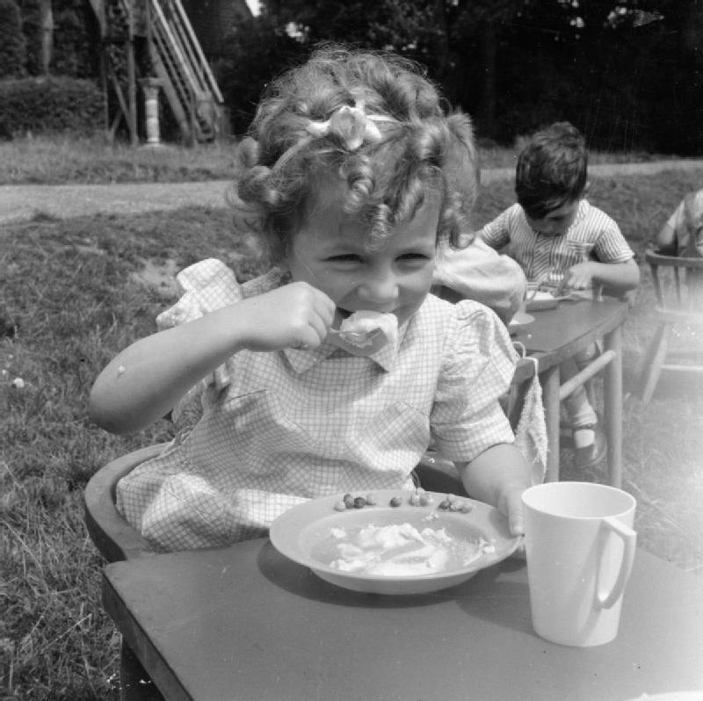

Slide 18
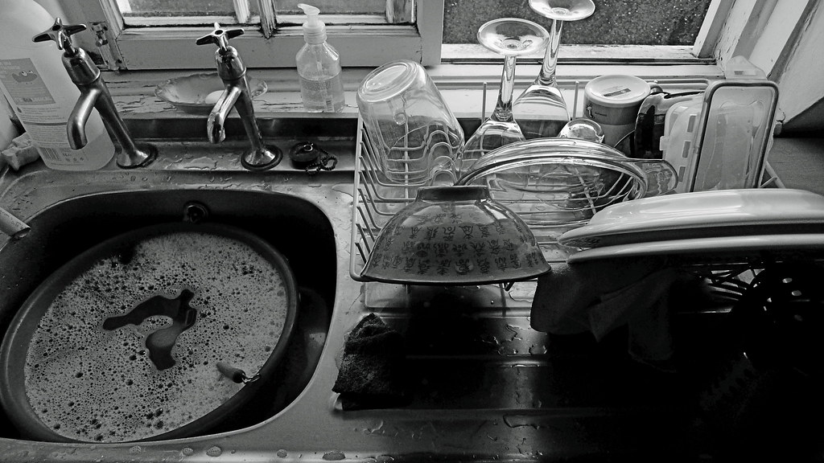

Slide 19


