Slide 1
Simply sounds…
Sounds of a walk round Thornton reservoir

Slide 3
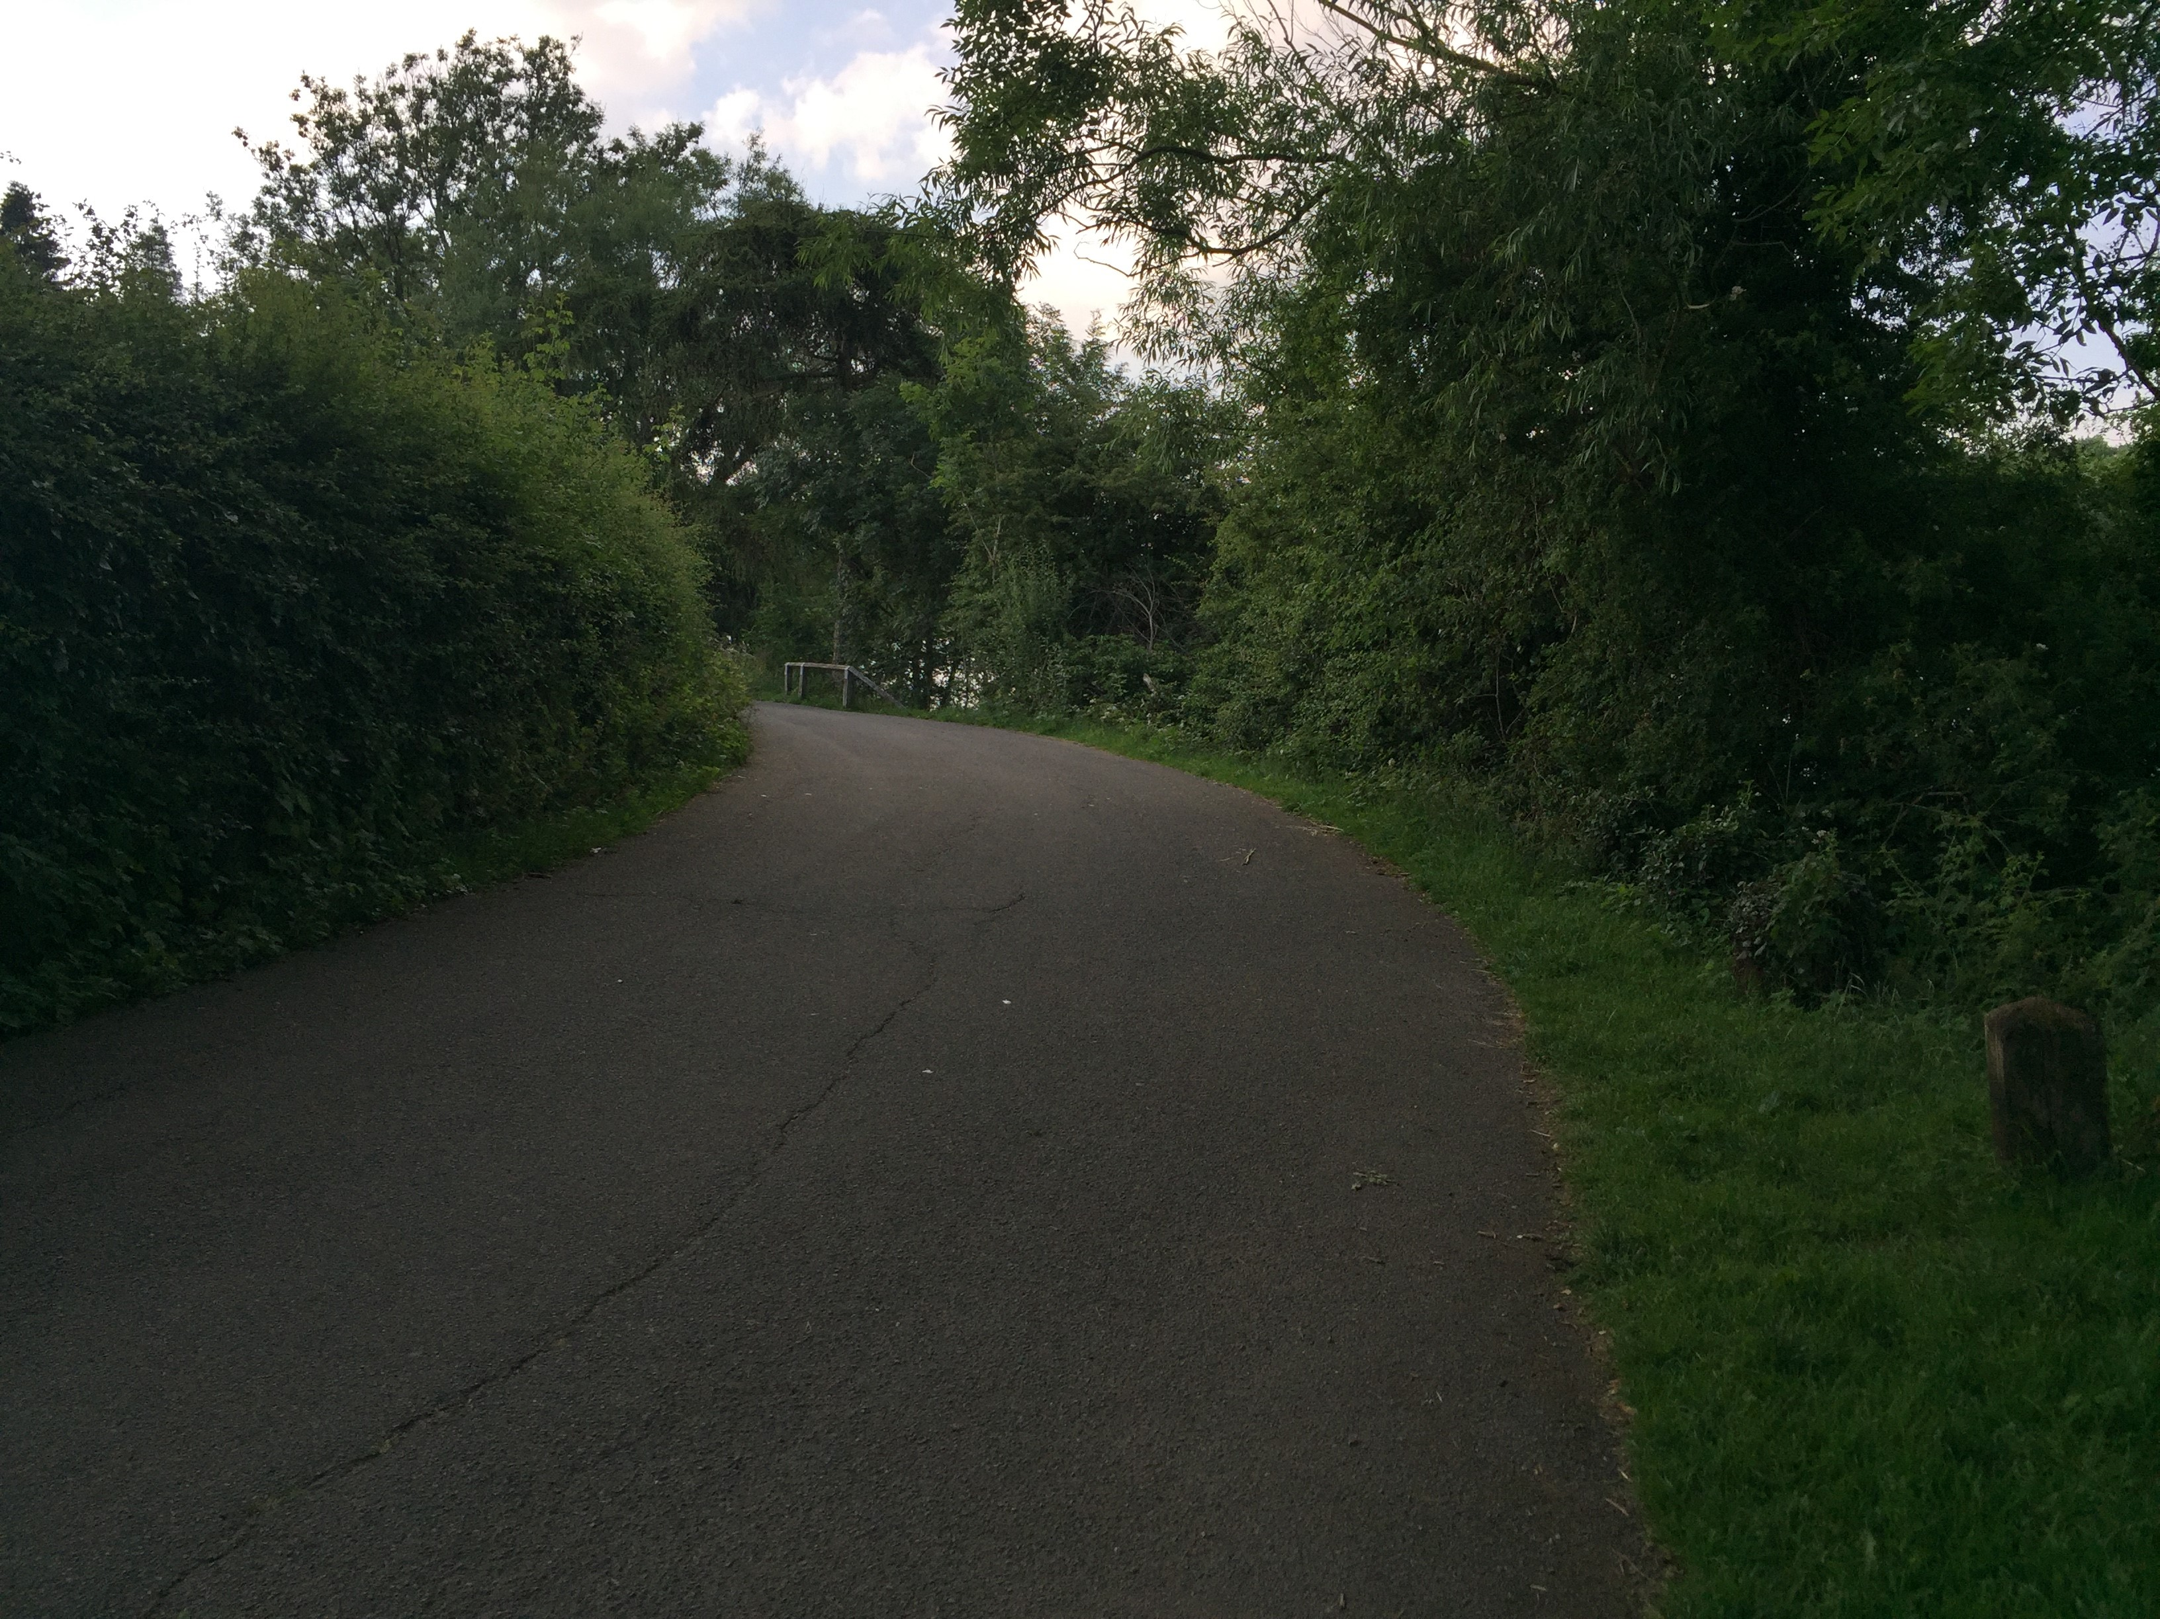

Slide 4
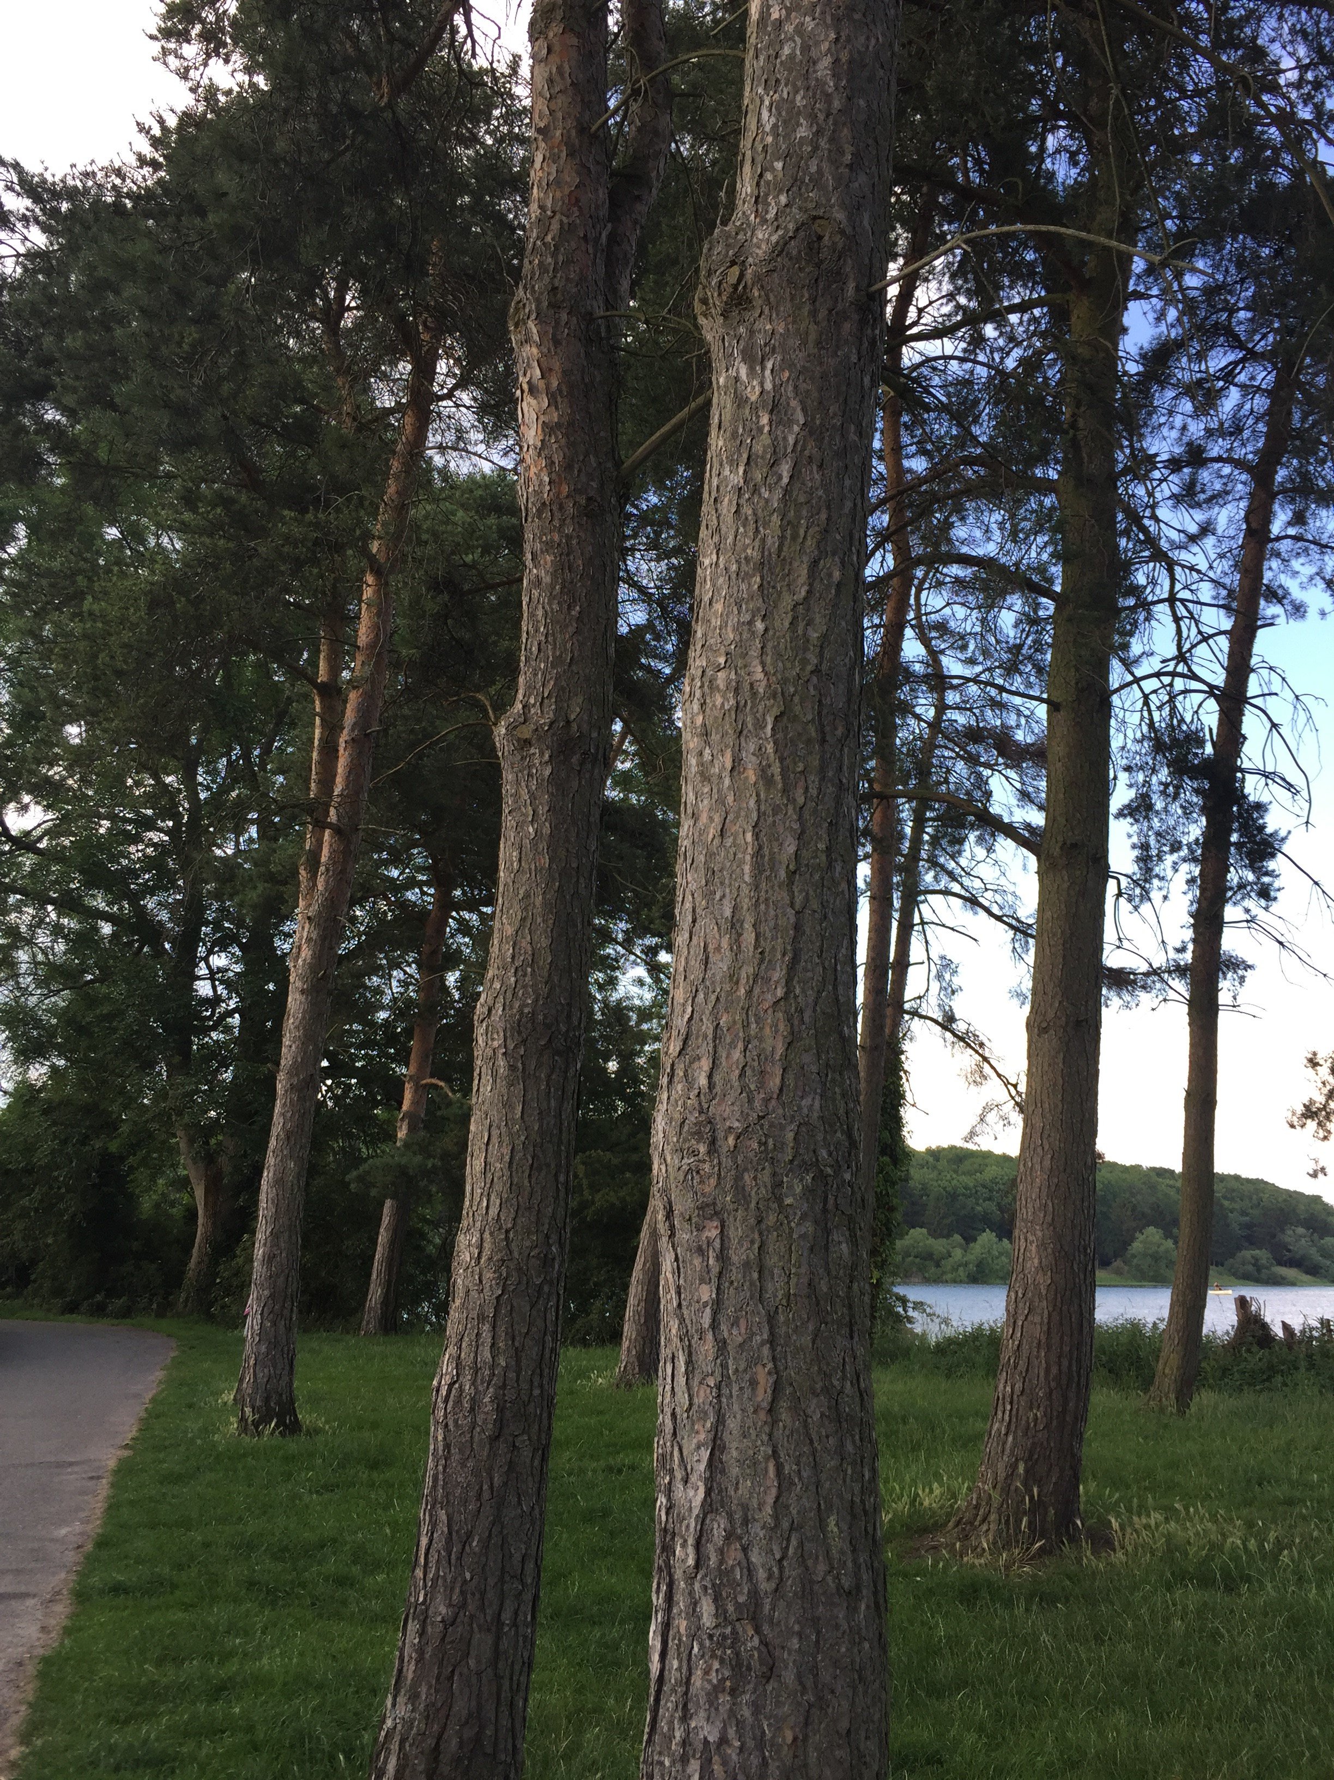

Slide 5
Unlocking Our Sound Heritage
The University of Leicester is one of ten regional hubs across the UK to join the British Library’s Unlocking Our Sound Heritage project, funded by the Heritage Lottery Fund (HLF). This ambitious project is part of the wider Save Our Sounds programme, which aims to:
Digitally preserve almost half a million rare and at-risk sound recordings
Establish a network of audio preservation centres across the UK
Engage more people with the value of sound recordings

