Slide 1
The sounds of Christmas shopping
What’s on your shopping list?

Slide 2
Have a chat about the following 4 photos showing things you might find in shops at Christmas.
Click on the word ‘SPIN’ to set the wheel spinning.
Click again to stop it.
Listen to the sound clip which matches your choice.
Talk about the things you like to buy and receive at Christmas.

Slide 3
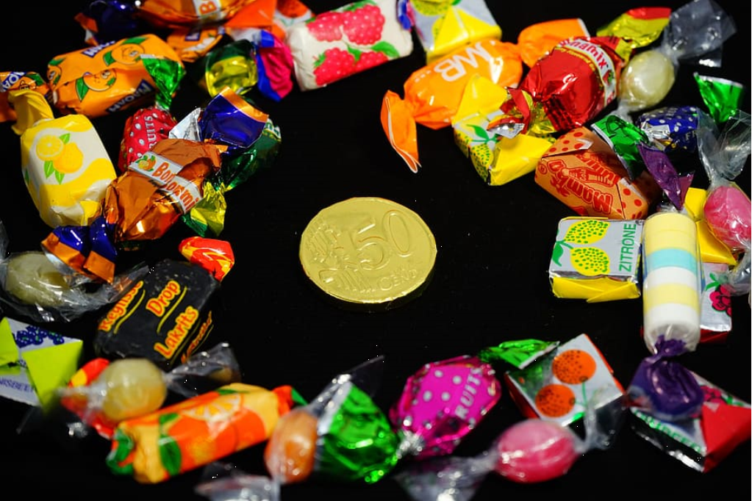

Slide 5
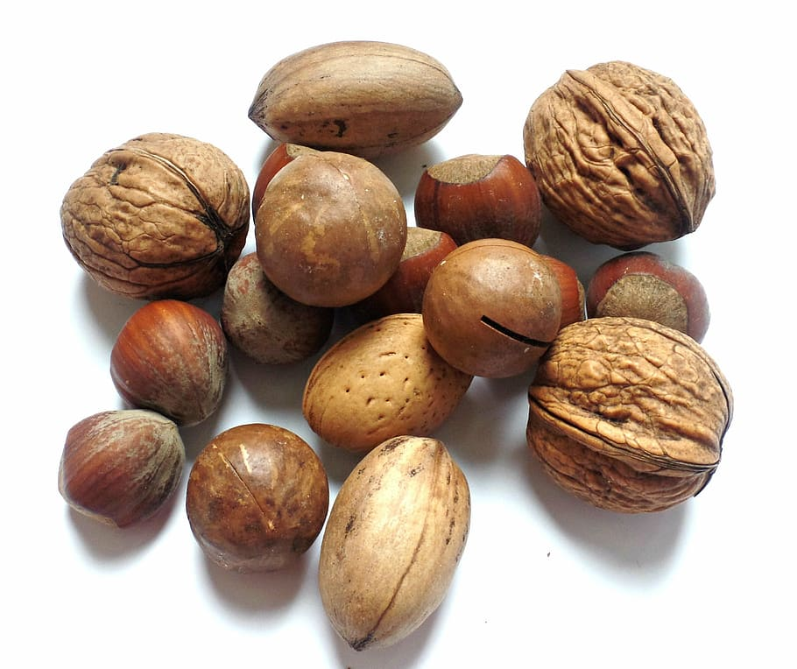

Slide 6
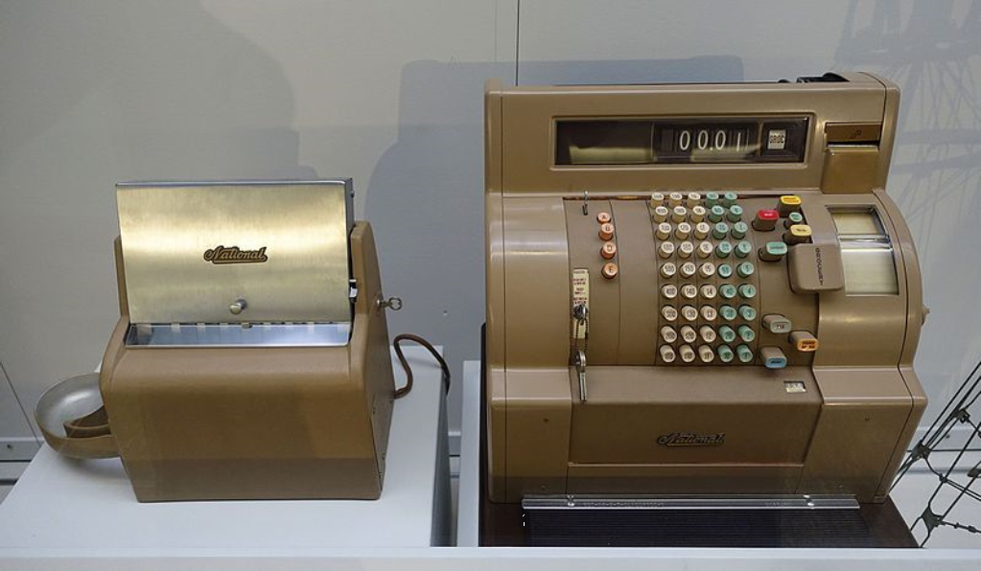

Slide 7
Wine and spirits
Nuts
Wine and spirits
Nuts
SPIN
Cash till
Sweets
Sweets
Cash till
tekhnologic
Notes:
4 Segments

