Slide 1
The wheel of fun
Sound Effects
What do you like to do in your Leisure time?

Slide 2

Have a chat about the following 4 photos showing things you might do for fun.
On the wheel of fun, click on the word ‘SPIN’ to set it spinning.
Click again to stop it.
Listen to the sound clip which matches your selected entertainment.
Talk about the things you like to do for fun in your leisure time.

Slide 3
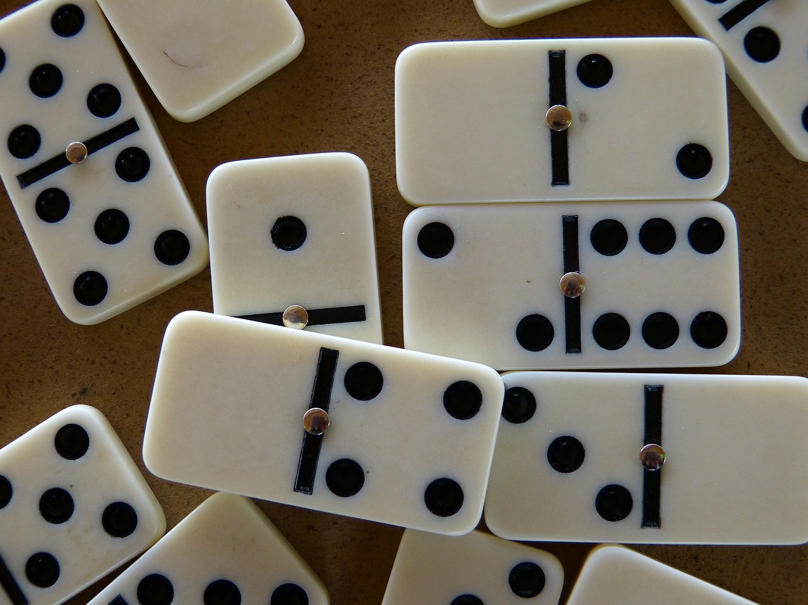

Slide 4
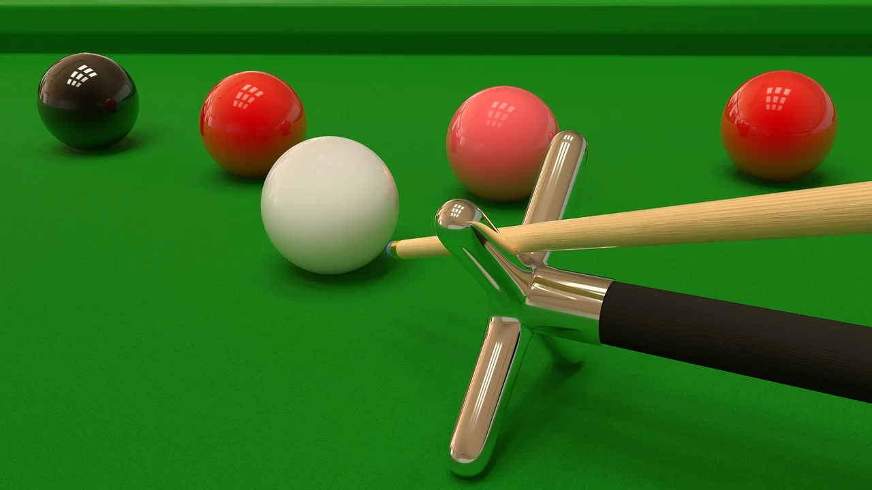

Slide 5
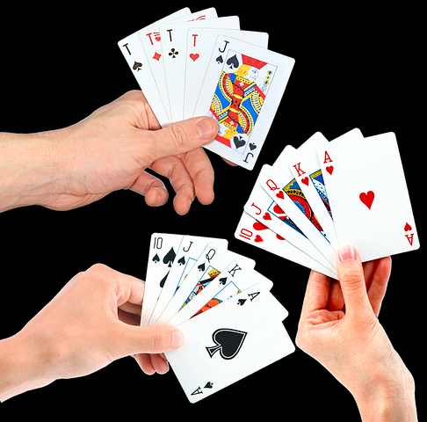

Slide 6
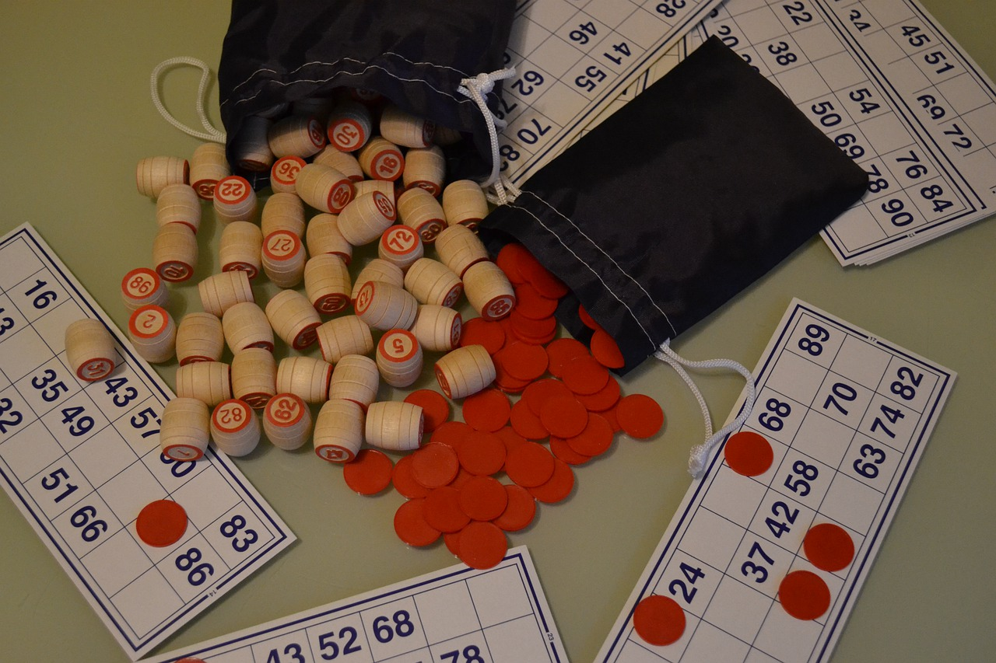

Slide 7



Dominoes
Snooker
Snooker
Cards
SPIN
Cards
Bingo
Bingo
Dominoes
tekhnologic
Notes:
4 Segments

