Slide 1
The wheel of fun
Sound Stories
What do you like to do in your Leisure time?

Slide 2

Have a chat about the following 4 photos showing things you might do for fun.
On the wheel of fun, click on the word ‘SPIN’ to set it spinning.
Click again to stop it.
Listen to the sound clip which matches your selected entertainment.
Talk about the things you like to do for fun in your leisure time.

Slide 3
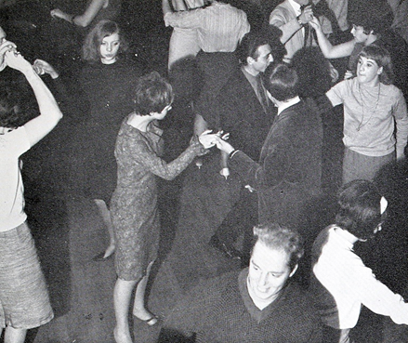

Slide 4
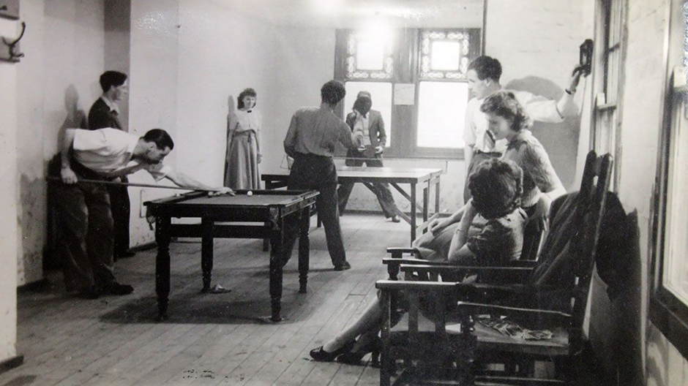

Slide 5
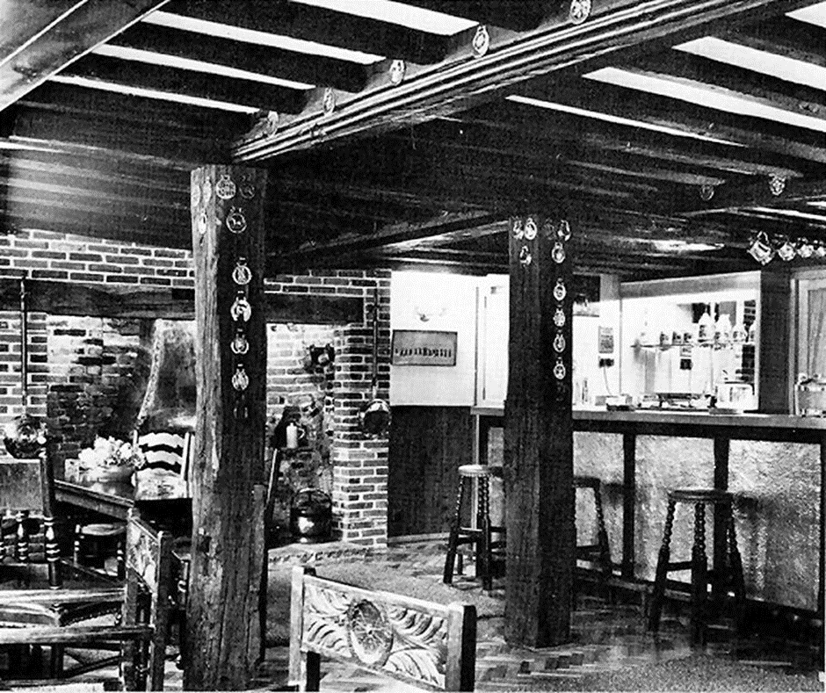

Slide 6
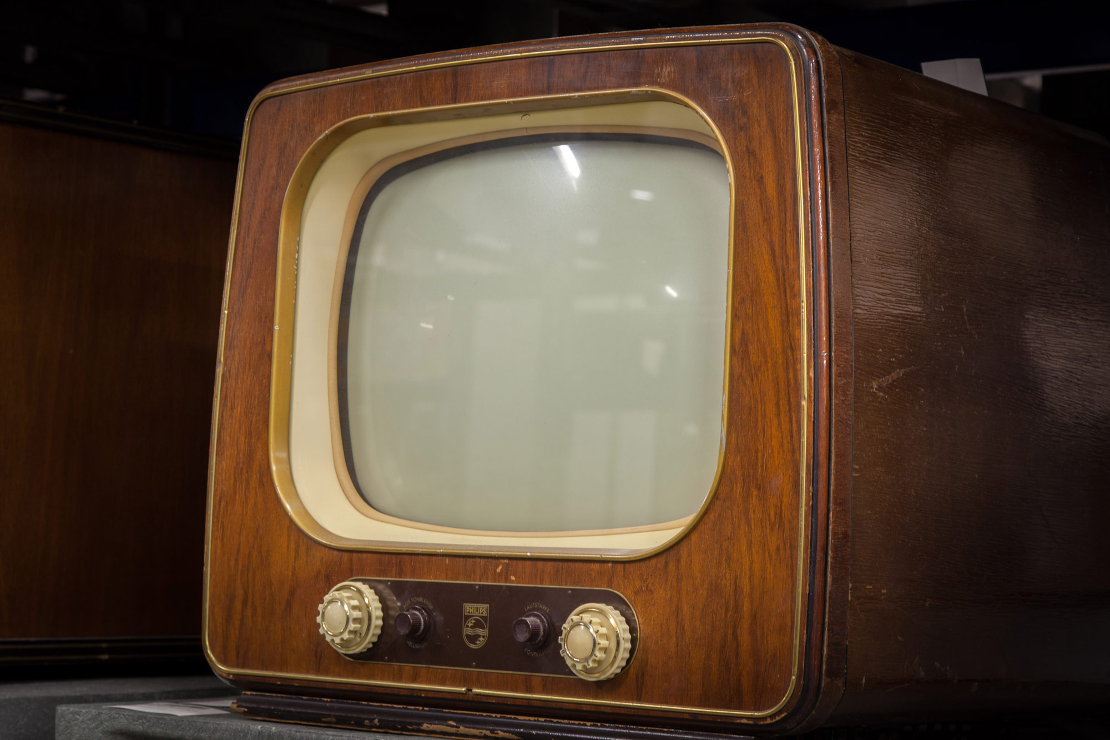

Slide 7



Watch TV
Burlesque Club
Youth Institute
Burlesque Club
SPIN
Youth Institute
Brass House Pub
Watch TV
Brass House Pub
tekhnologic
Notes:
4 Segments

