Slide 1
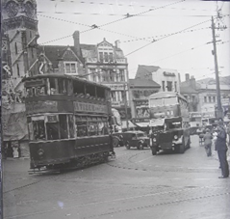
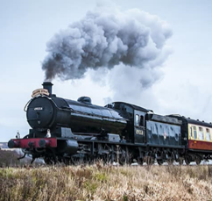
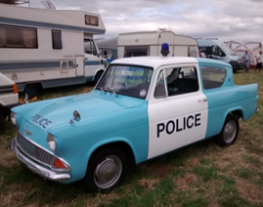
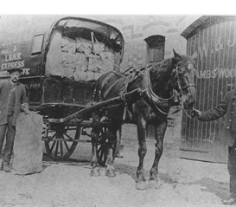
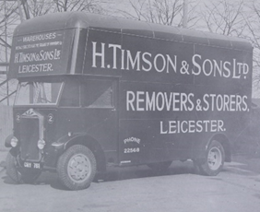
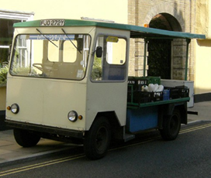
Tram
Steam Train
Police Car
Milk Float
Horse and Cart
Lorry

Slide 2
The Gasman Cometh
Flanders and Swann 1963
T'was on the Monday morning, the gas man came to call, The gas tap wouldn't turn, I wasn't getting gas at all; He tore out all the skirting boards to try and find the main, And I had to call a carpenter to put them back again!
Oh, it all makes work for the working man to do...

Slide 3
T'was on the Tuesday morning, the carpenter came round: He hammered and he chiseled and he said "Look what I've found! Your joists are full of dry rot, but I'll put them all to rights!" Then he nailed right through a cable and out went all the lights!
Oh, it all makes work for the working man to do...

Slide 4
T'was on a Wednesday morning, the electrician came: He called me 'Mr. Sanderson', which isn't quite the name; He couldn't reach the fuse box without standing on the bin, And his foot went through a window, so I called the glazier in!
Oh, it all makes work for the working man to do...

Slide 5
T'was on the Thursday morning, the glazier came along With his blowtorch, and his putty, and his merry glazier's song; He put another pane in, it took no time at all But I had to get a painter in to come and paint the wall!
Oh, it all makes work for the working man to do...

Slide 6
T'was on a Friday morning the painter made a start, With undercoats and overcoats he painted every part, Every nook and every cranny; but I found when he was gone He'd painted over the gas tap and I couldn't turn it on!
Oh, it all makes work for the working man to do...
On Saturday and Sunday they do no work at all; So it was on the Monday morning that the gas man came to call!

Slide 7
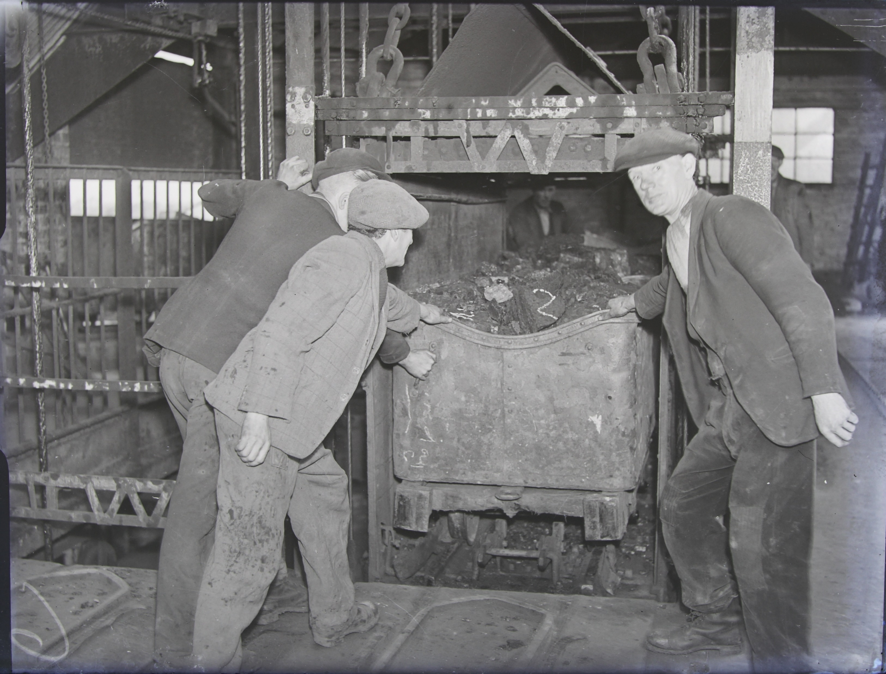

Slide 8
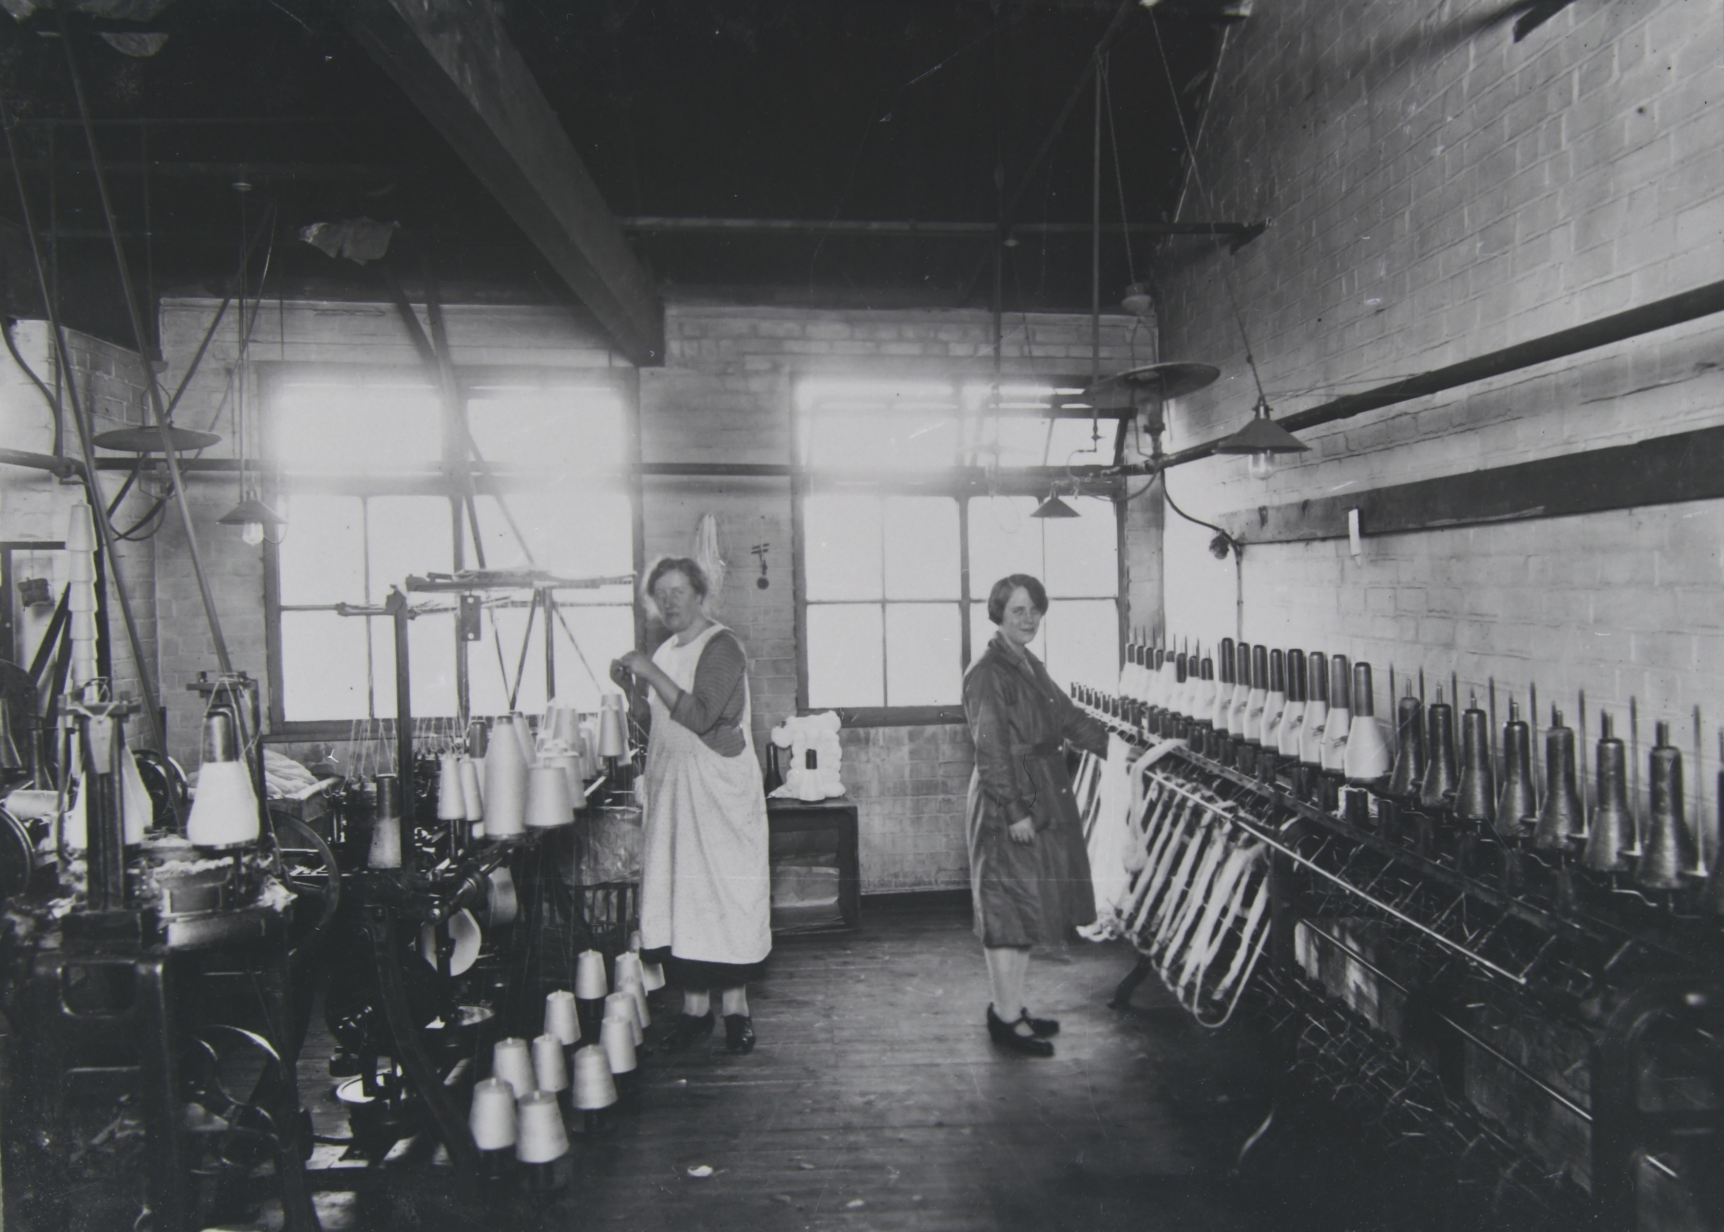

Slide 9
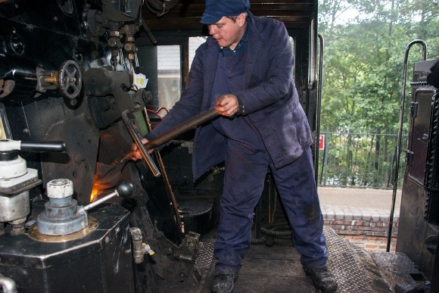

Slide 10
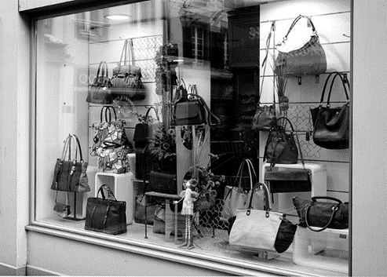

Slide 11
Morningtown Ride - The Seekers 1966
Train whistle blowin' Makes a sleepy noise Underneath the blankets For all the girls and boys
Rockin' rollin' ridin' Out along the bay All bound for Morningtown Many miles away

Slide 12
Driver at the engine Fireman rings the bell Sandman swings the lantern To show that all is well
Rockin' rollin' ridin' Out along the bay All bound for Morningtown Many miles away

Slide 13
Maybe it is raining Where our train will ride All the little travellers Are warm and snug inside
Rocking, rolling, riding Out along the bay All bound for Morningtown Many miles away

Slide 14
Somewhere there is sunshine Somewhere there is day Somewhere there is Morningtown Many miles away
Rocking, rolling, riding Out along the bay All bound for Morningtown Many miles away

Slide 15
Rocking, rolling, riding Out along the bay All bound for Morningtown Many miles away.

Slide 16
Simply sounds…
Sounds of a weaver at work

Slide 17
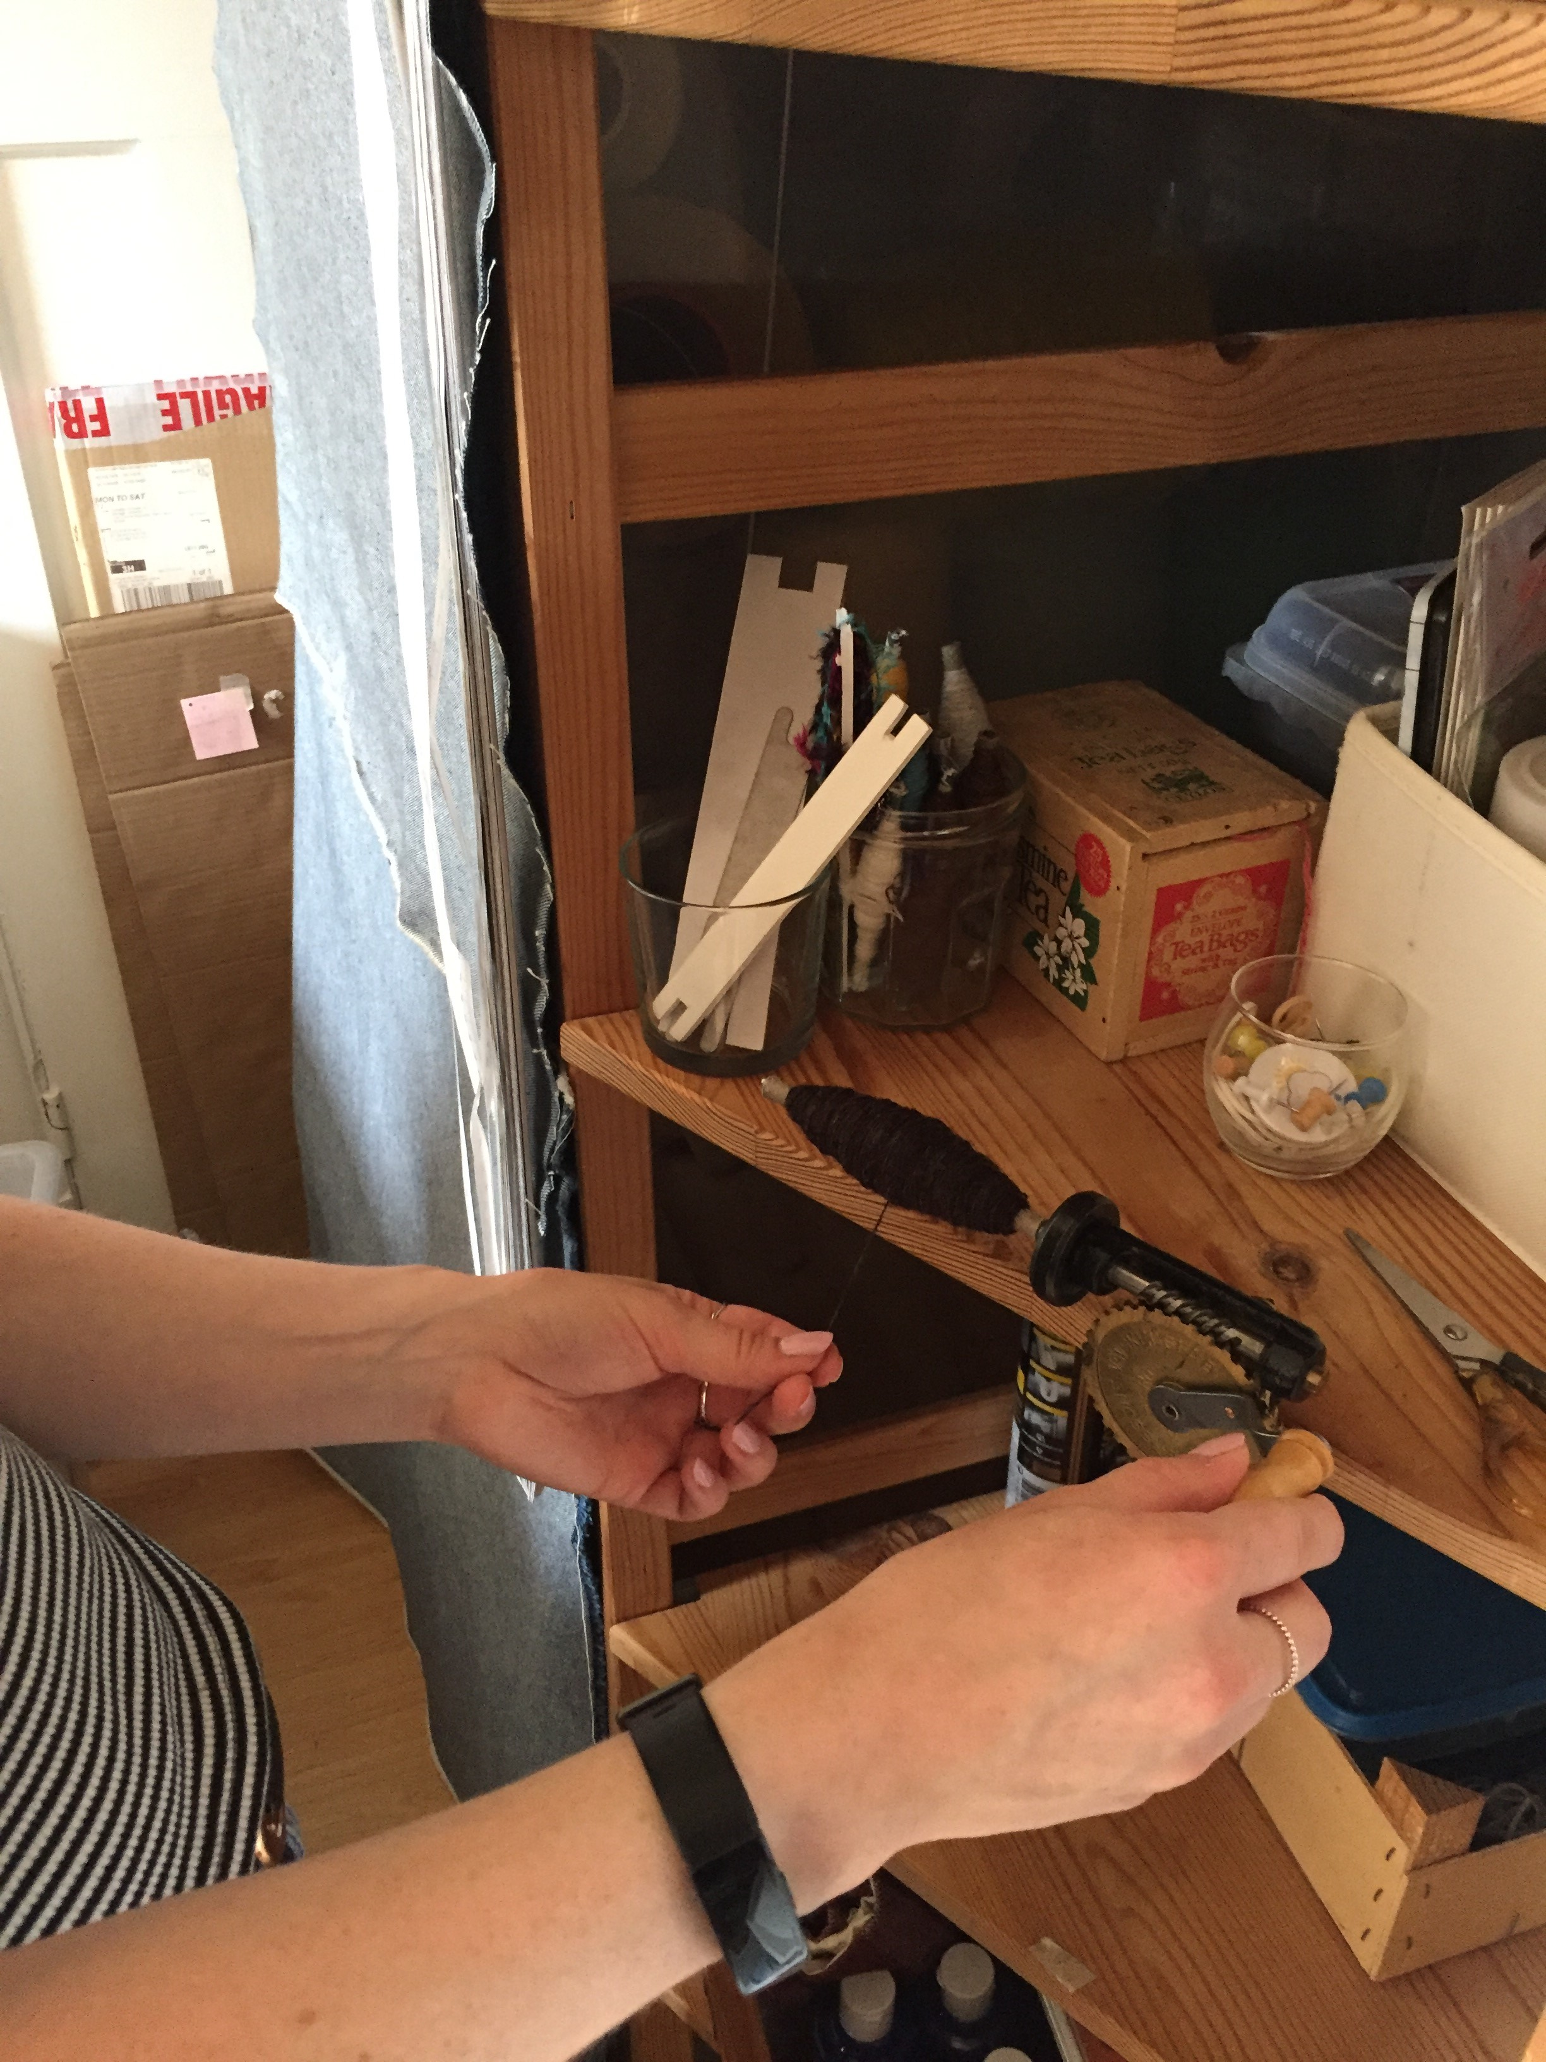

Slide 18
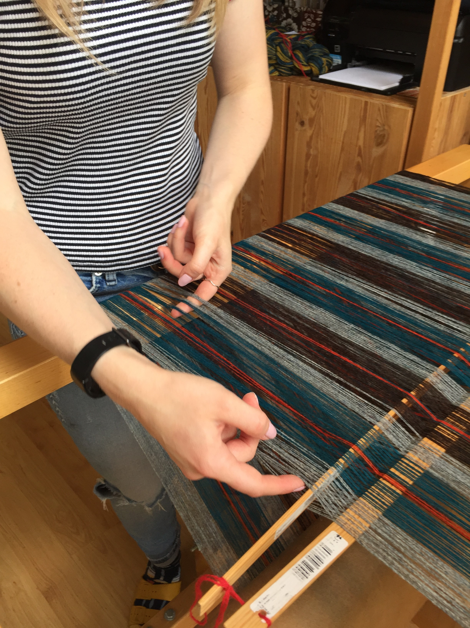

Slide 19
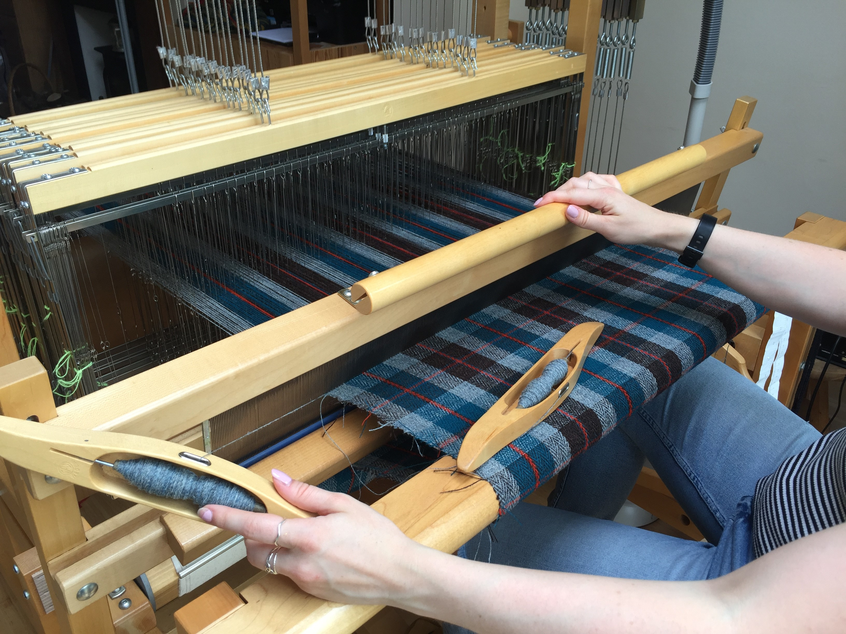

Slide 20
Keep that wheel a turning
First published in 1927 in the ILP Songbook (Independent Labour Party)
A right young lad was William Brown, He worked for a wage in a Yorkshire town, He turned a wheel from left to right, From eight at morn till six at night.
Keep that wheel a turning, Keep that wheel a turning, Keep that wheel a turning And do a little more each day.

Slide 21
The boss one day to William came, He says, “Look here, young What’s-yer-name; We’re far from pleased with what you do, Hurry that wheel or out you go!”
Keep that wheel a turning, Keep that wheel a turning, Keep that wheel a turning And do a little more each day.
Instrumental

Slide 22
Now William turned, and he made her run, Three times round instead of one. He turned so hard he was quickly made, The Royal High Turner of his trade.
Keep that wheel a turning, Keep that wheel a turning, Keep that wheel a turning And do a little more each day.

Slide 23
Now William turned with a saintly smile, The goods they grew to such a pile; They filled his room and the room next door, And overflowed to the basement floor.
Now Keep that wheel a turning, Keep that wheel a turning, Keep that wheel a turning And do a little more each day.
Instrumental

Slide 24
The nation thrilled to the wonderous tale
The news appeared in the Sketch and the Mail
The railways brought excursions down
All for to gaze on William Brown
Now Keep that wheel a turning, Keep that wheel a turning, Keep that wheel a turning And do a little more each day.

Slide 25
But sad the sequel now to tell, He turned out more than the boss could sell, The market fell and the price came down
Seven more days and they sacked young Brown
Now Keep that wheel a turning, Keep that wheel a turning, Keep that wheel a turning And do a little more each day.

Slide 26
