Slide 1
Fantastical Fairgrounds
The History of Loughborough Market and Fair
Key Stage 1

Slide 2
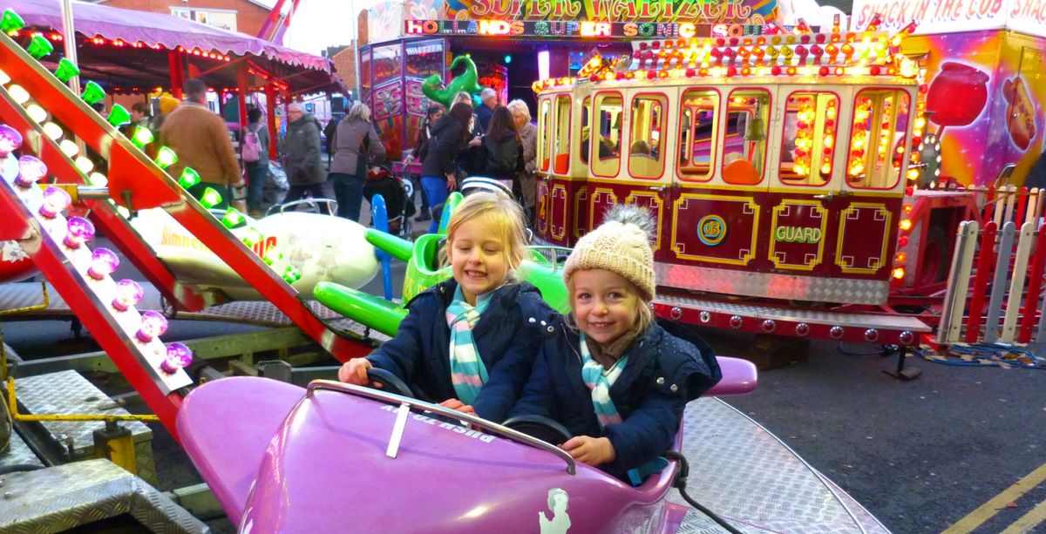

Slide 3
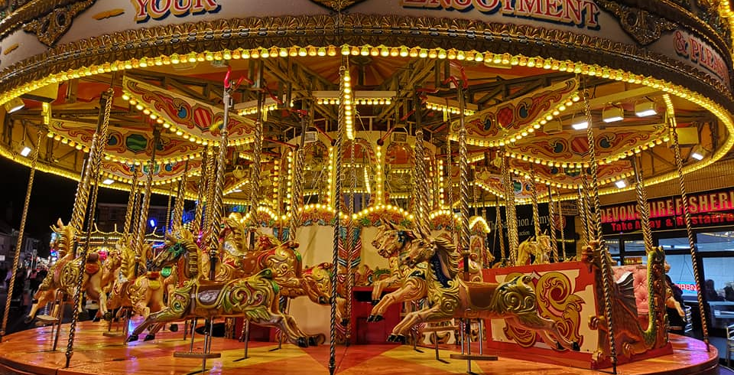

Slide 4
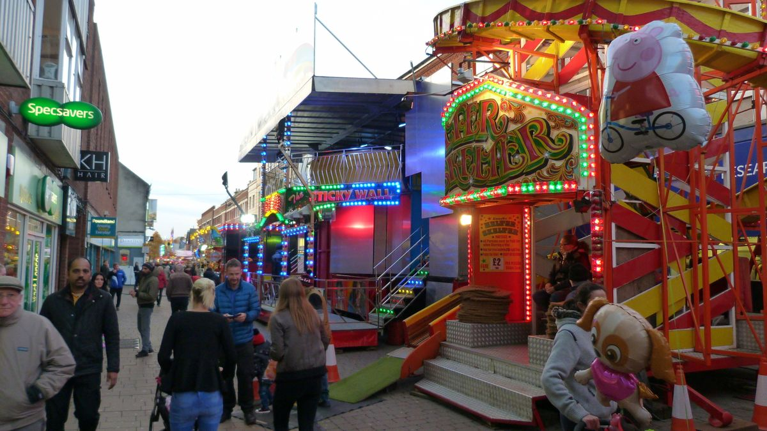

Slide 5
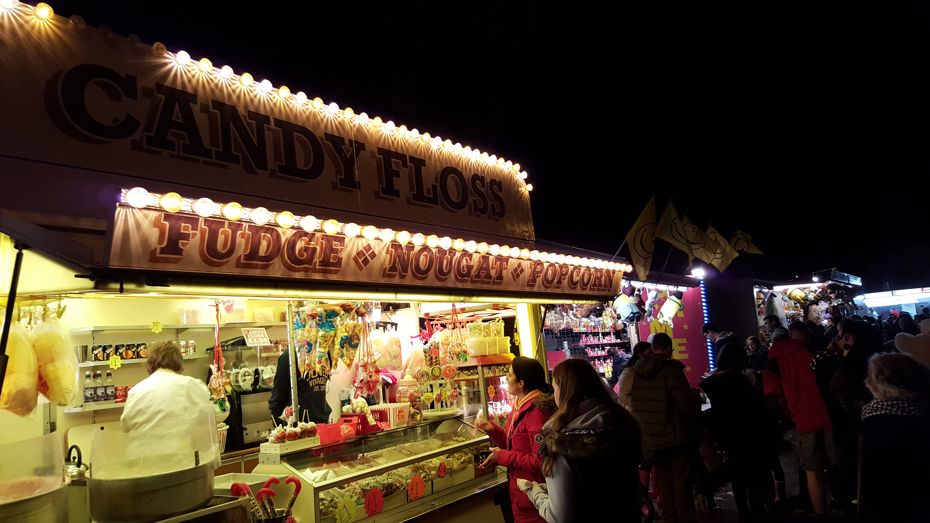

Slide 6
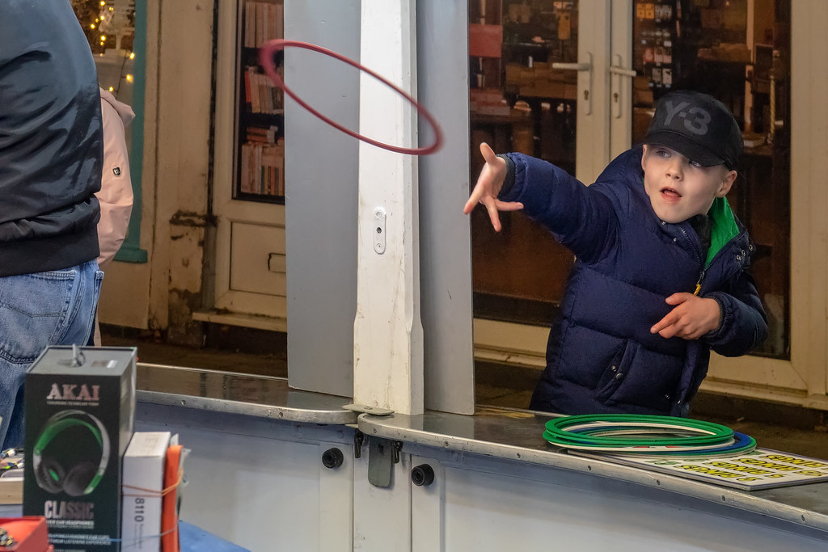

Slide 7
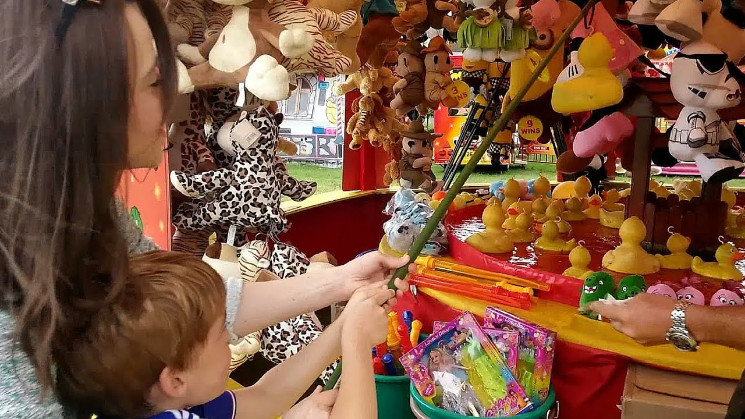

Slide 8
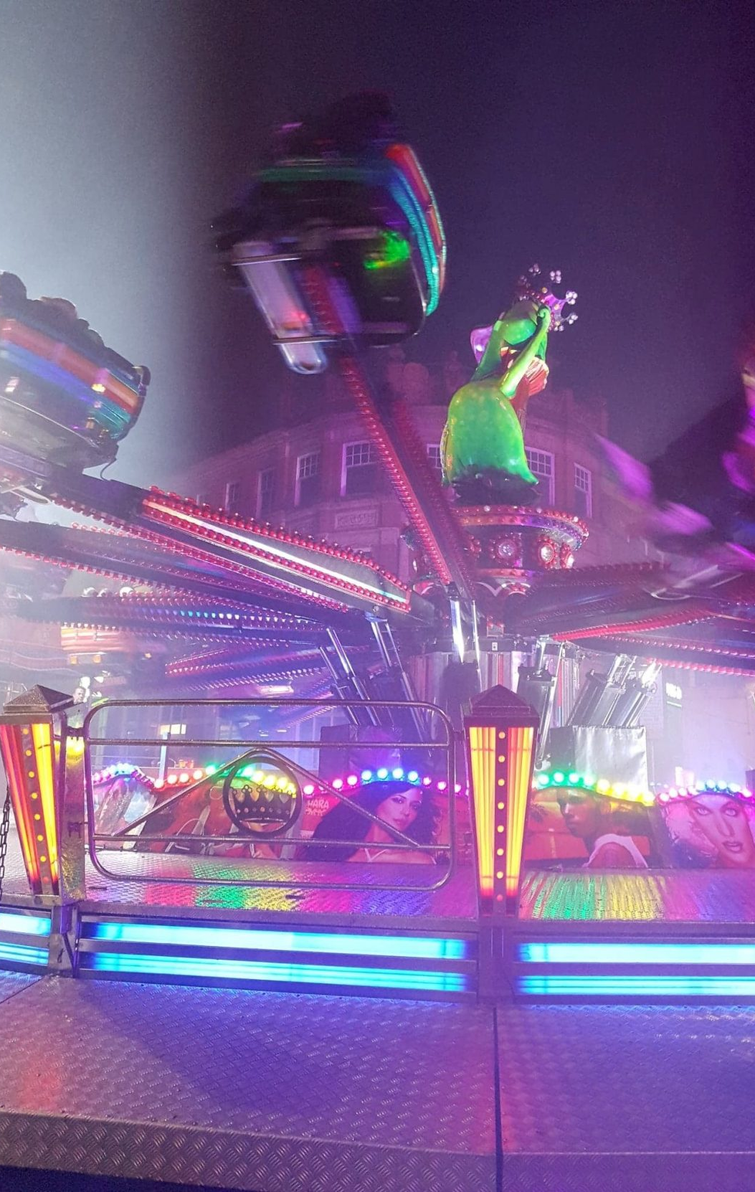
Clips to watch
Some rides are big and scary – spin the picture so you can see it. What can you hear? Would you go on this ride?
https://www.youtube.com/watch?v=66HaZunFGY0
Listen to the sounds of the fair, what rides and stalls can you see? – spin the pictures so you can see everything.
https://www.youtube.com/playlist?list=PLvNfbLt9wrkOEN2Gl0DfLpB2ucIeYjD9z
Look at the fair at night. Does it look different to the daytime? What rides can you see? What can you hear?
https://www.youtube.com/watch?v=_1i5gokimlk

Slide 9
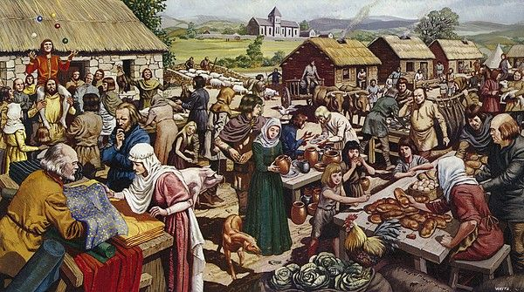

Slide 10
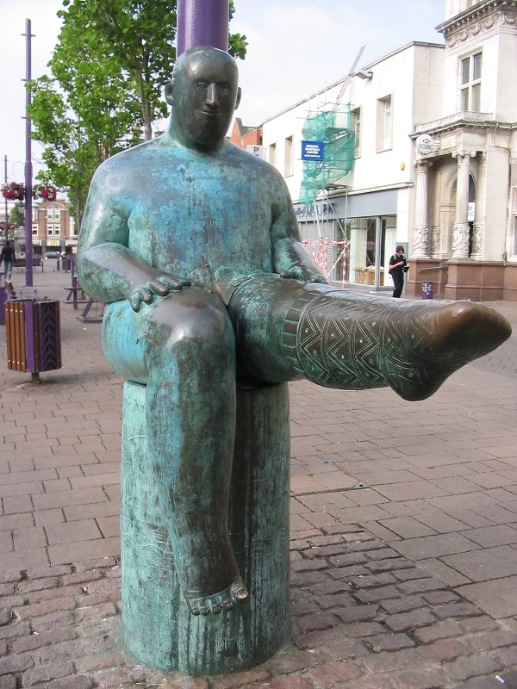
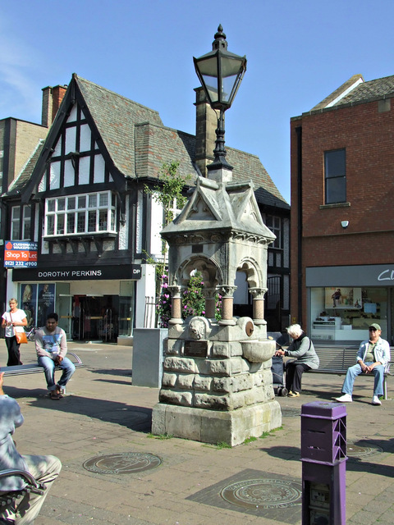

Slide 12
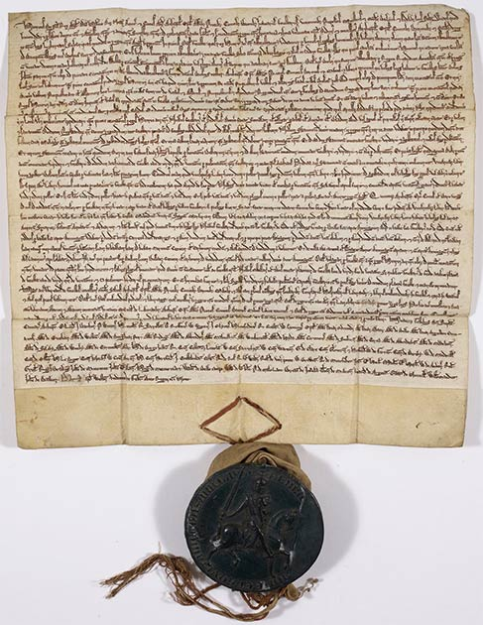
https://www.youtube.com/watch?v=OMNqS2-jDgE

Slide 14
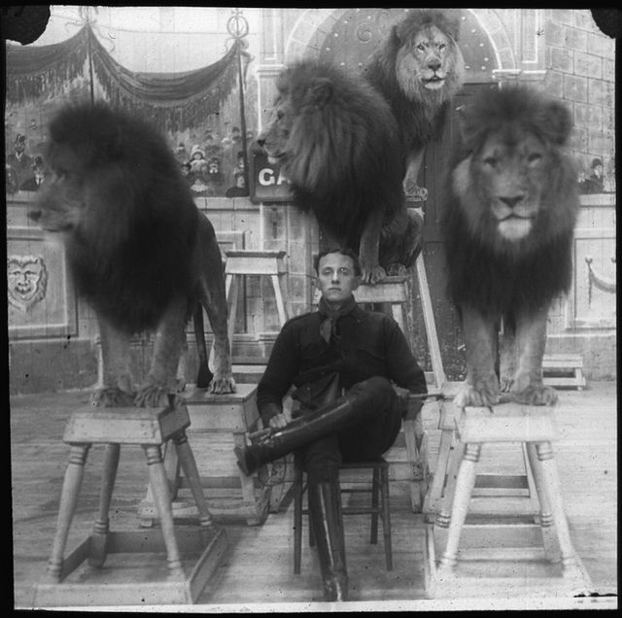

Slide 15
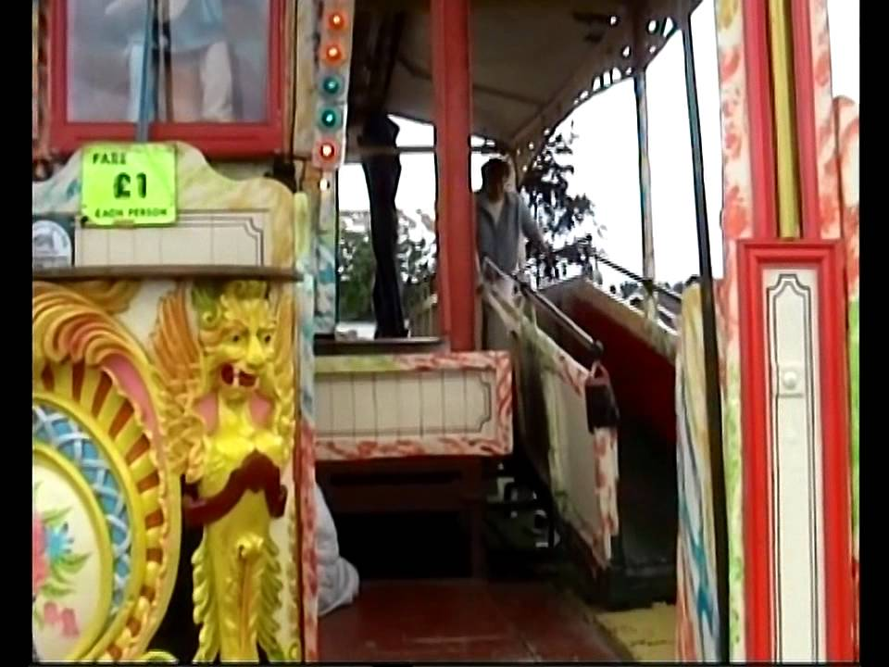

Slide 16
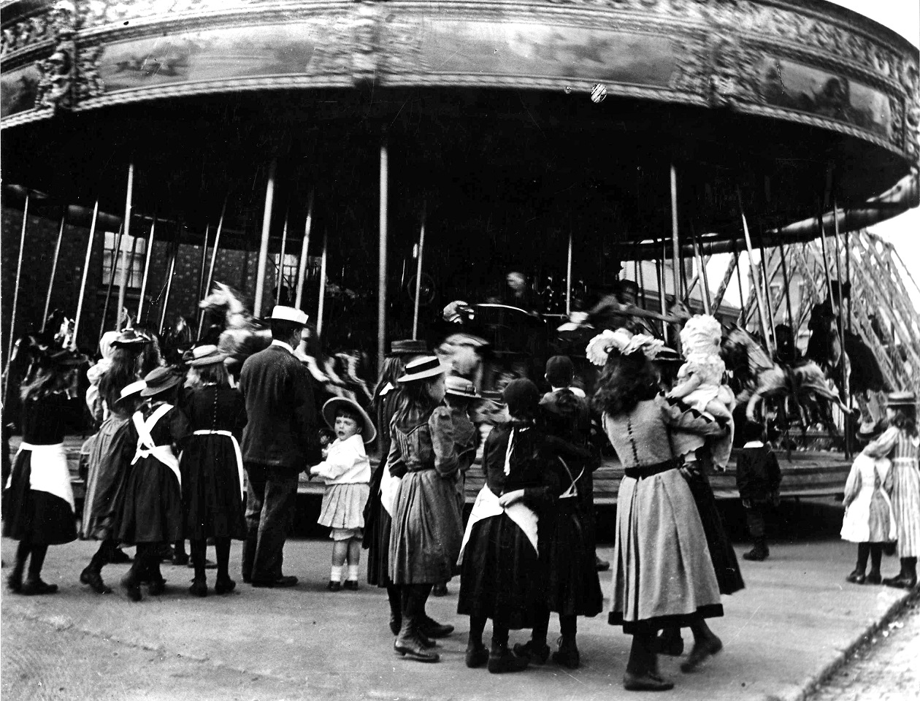

Slide 17
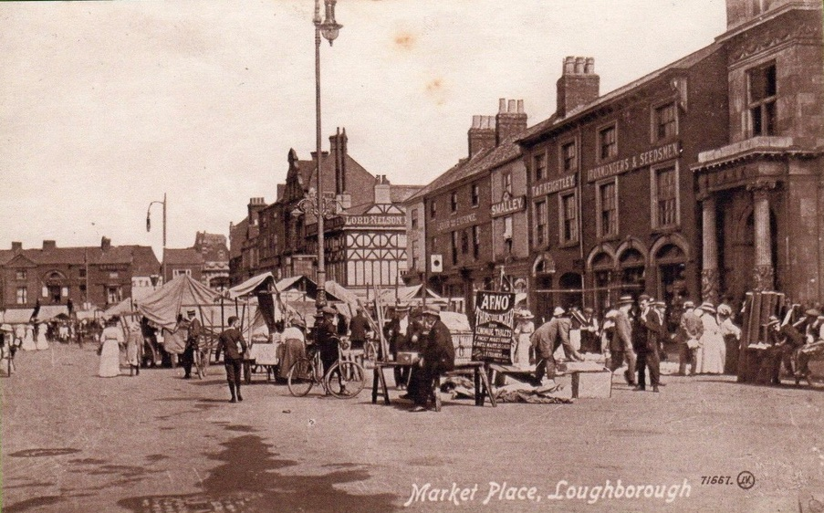

Slide 18
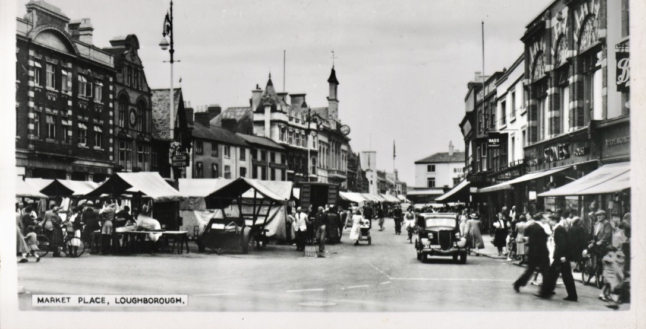

Slide 19
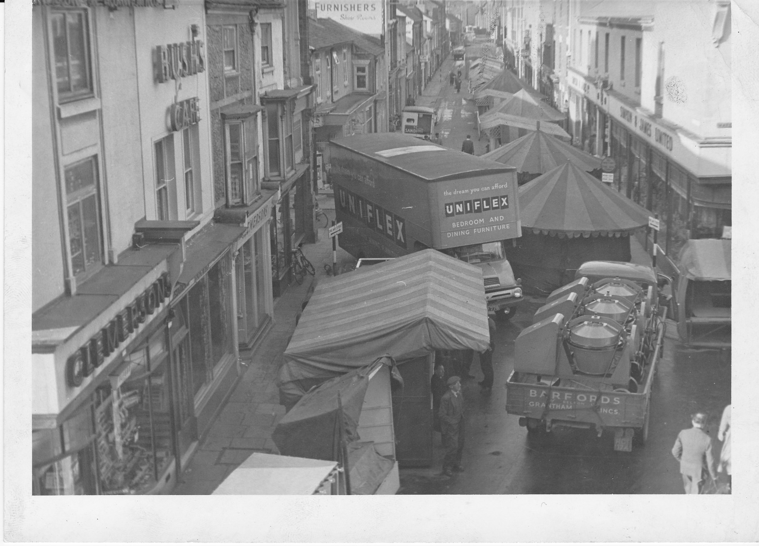

Slide 20
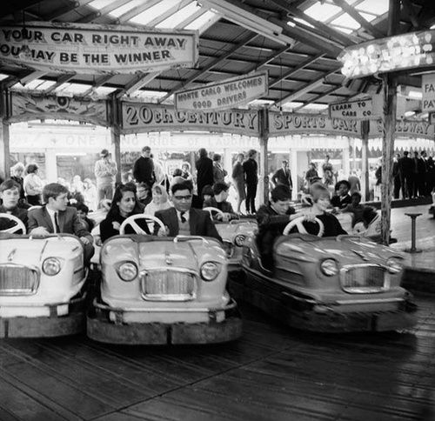

Slide 21
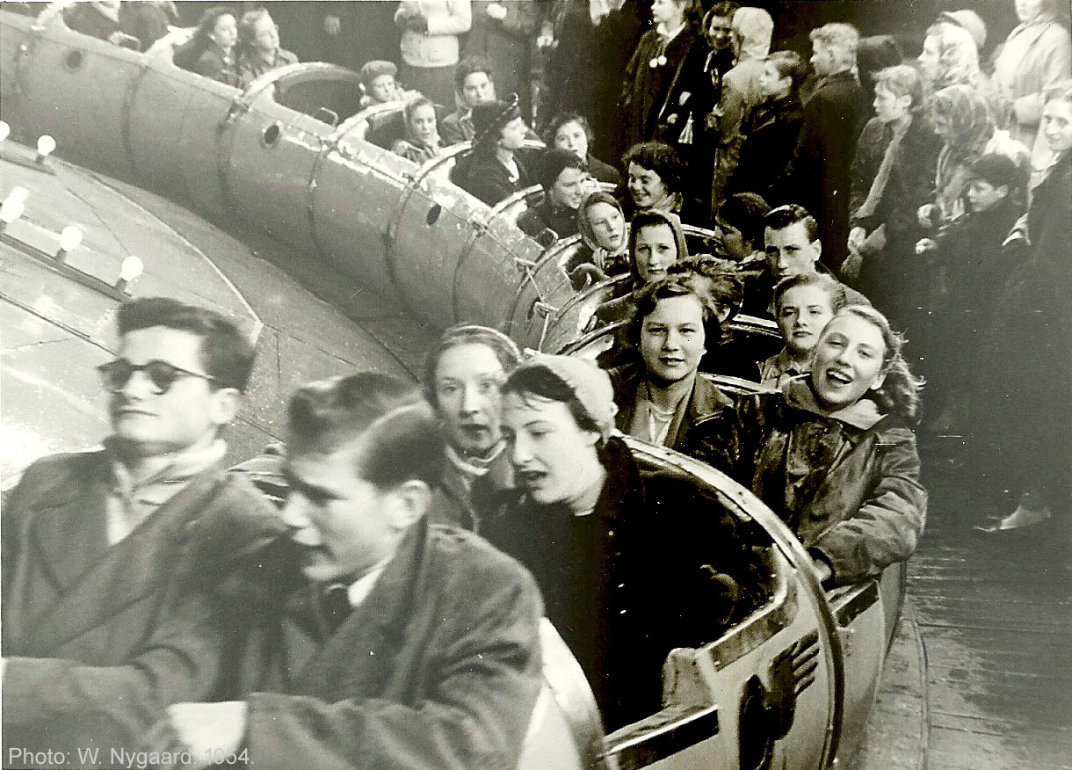

Slide 22
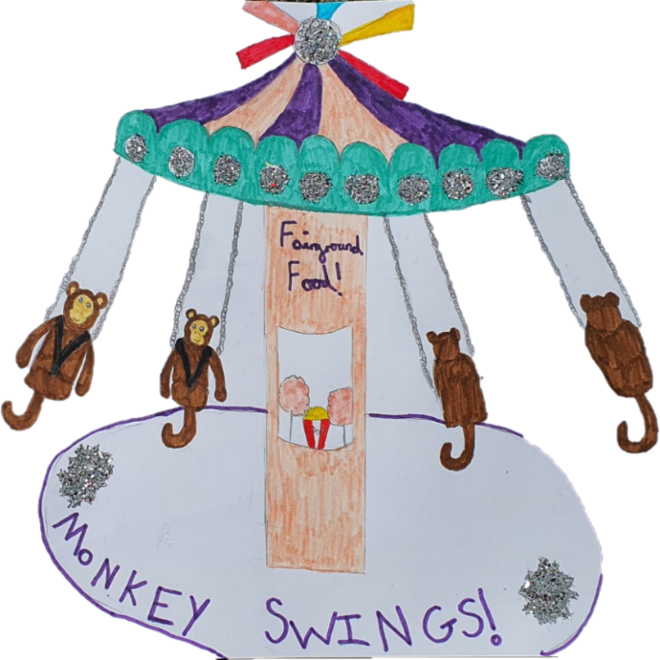
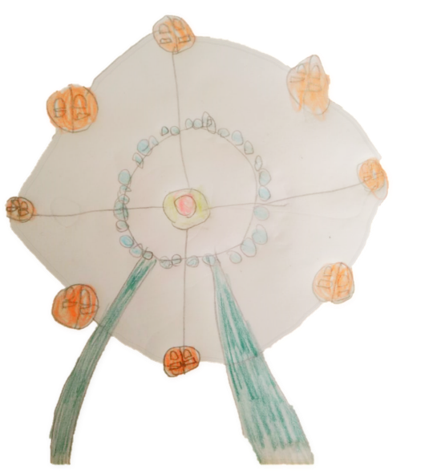

Slide 23
Further Events you can visit with family and friends this year.
Our Market, Our Fair, Loughborough Town Hall Exhibition will be on display from 14th October - 18th November 2021
Our Market, Our Fair, Charnwood Museum Exhibition will be on display from 10th July – 18th December 2021

