Slide 1
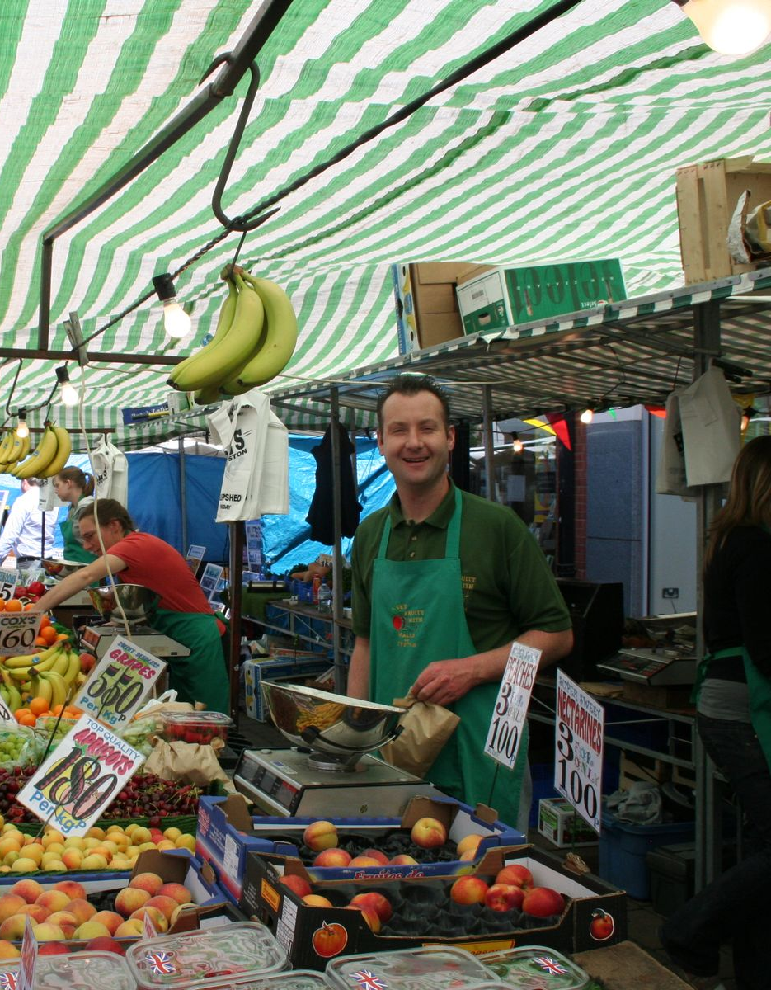
Magical Markets
The History of Loughborough Market
Key Stage 2

Slide 2
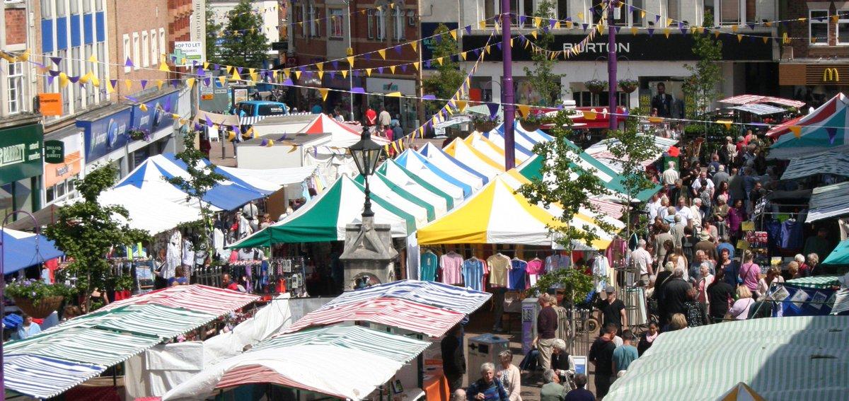

Slide 3
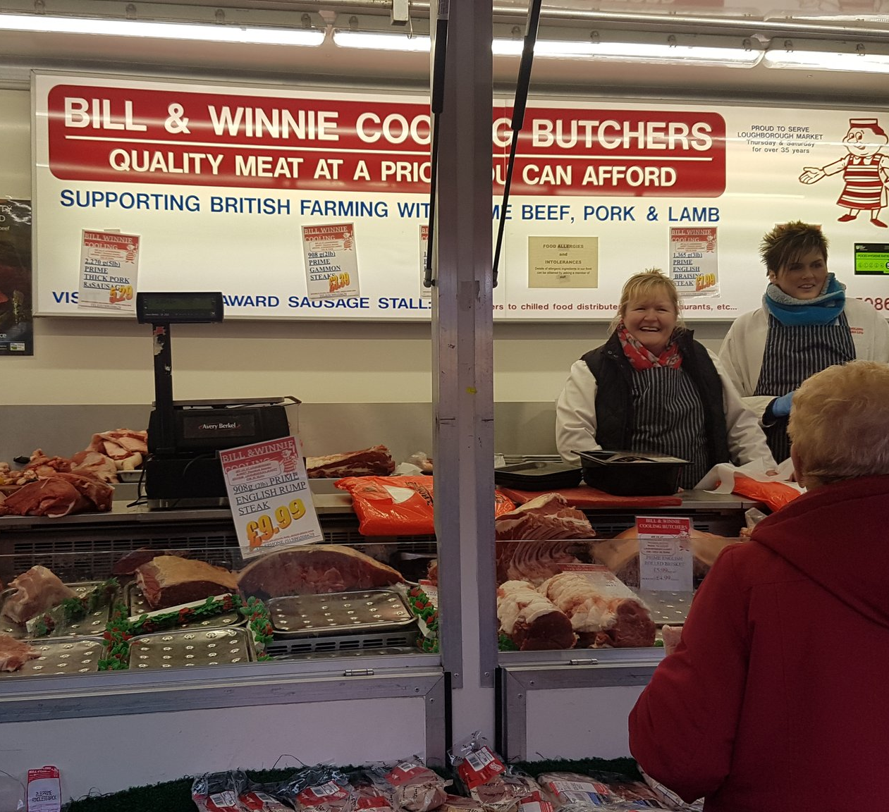
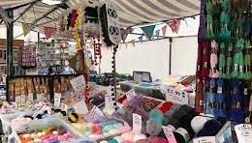
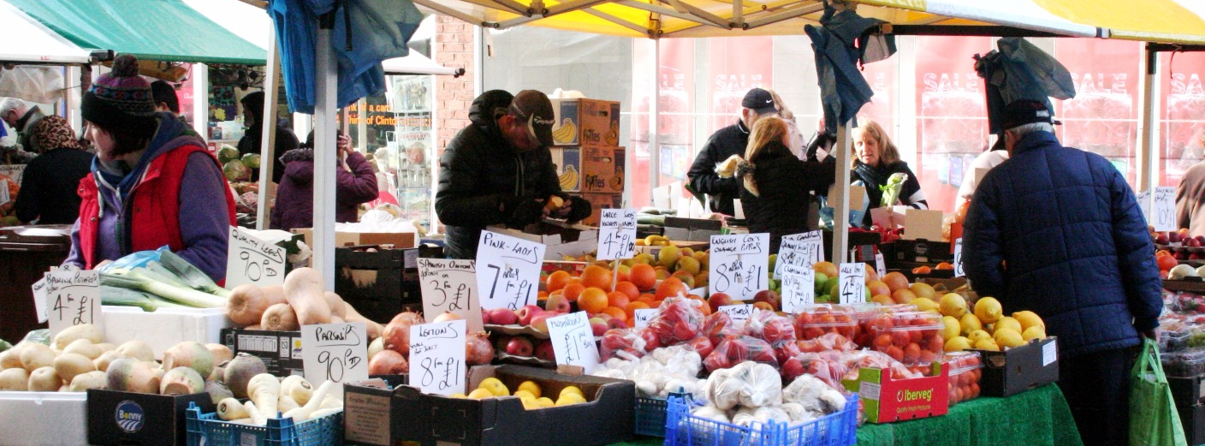

Slide 4
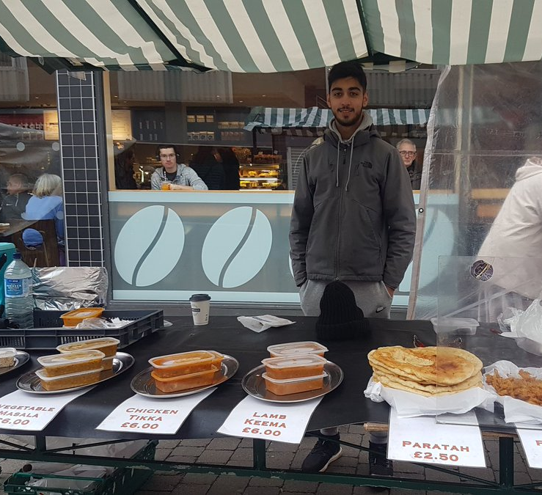
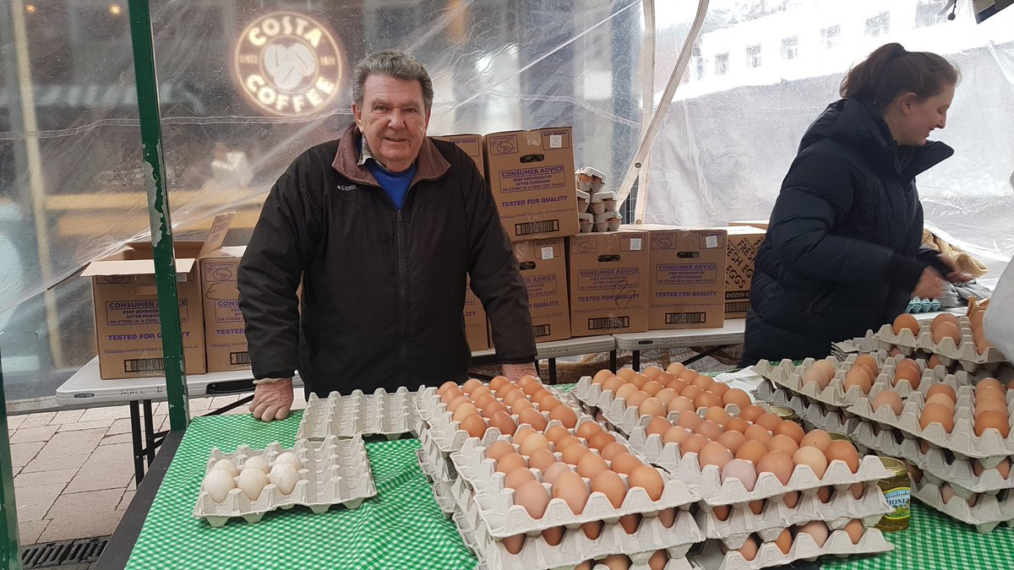
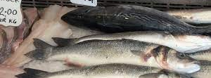

Slide 5
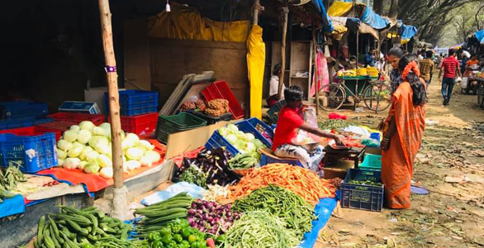

Slide 6
Useful Clips to watch:
https://youtu.be/R-BlhU0mQLo A walk around the market
https://fb.watch/4_yrI-Y5rR/ Fruit and veg stallholders
https://fb.watch/4_y_Cupu0S/ Haberdashery stalls
https://youtu.be/jw0QNPzhup0 Fishmongers
https://youtu.be/cKTYiHIWQP4 Socks and tights stall
https://fb.watch/4_z8L214Vg/ Bakery stall
https://fb.watch/4_yw7tuu3b/ Egg Stall

Slide 7
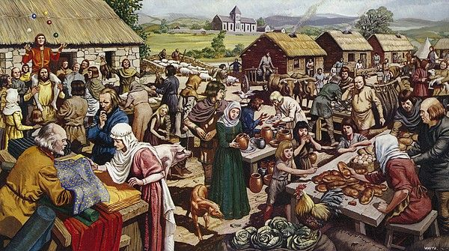

Slide 8
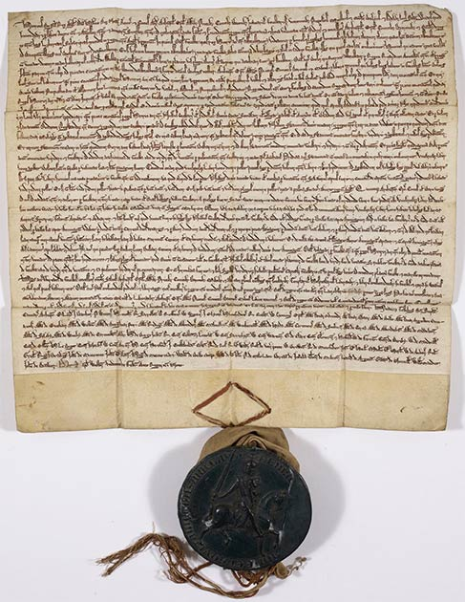
https://www.youtube.com/watch?v=OMNqS2-jDgE

Slide 10
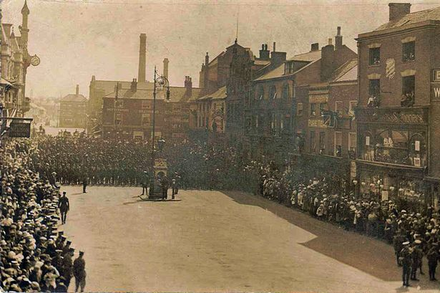

Slide 11
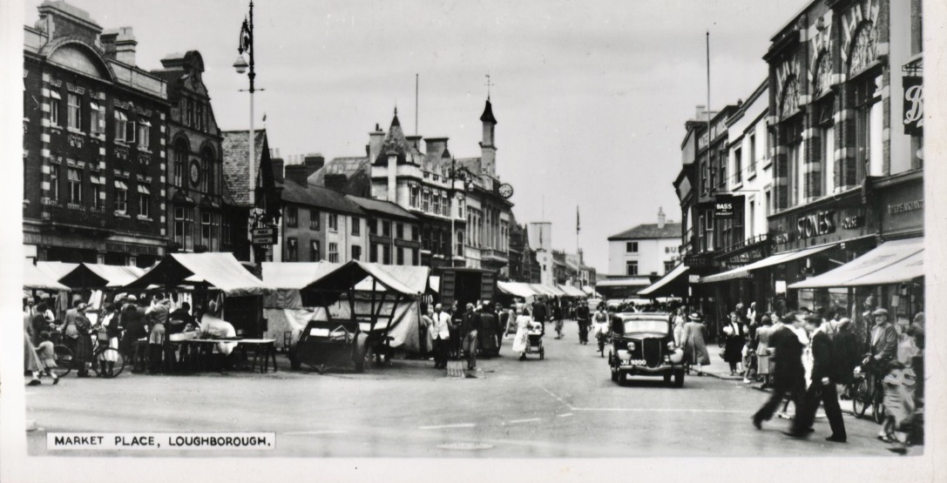

Slide 12
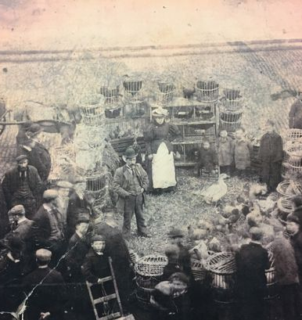
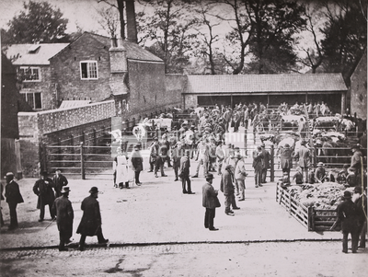

Slide 13
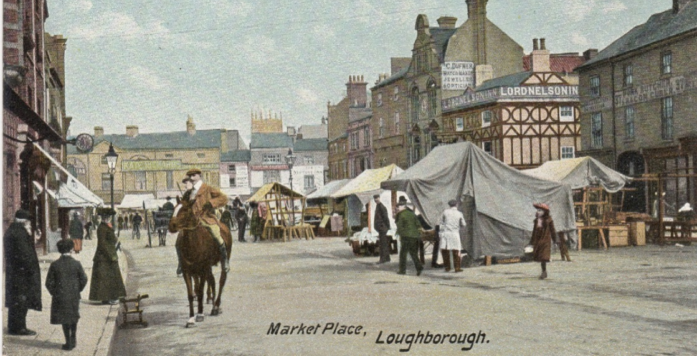

Slide 14
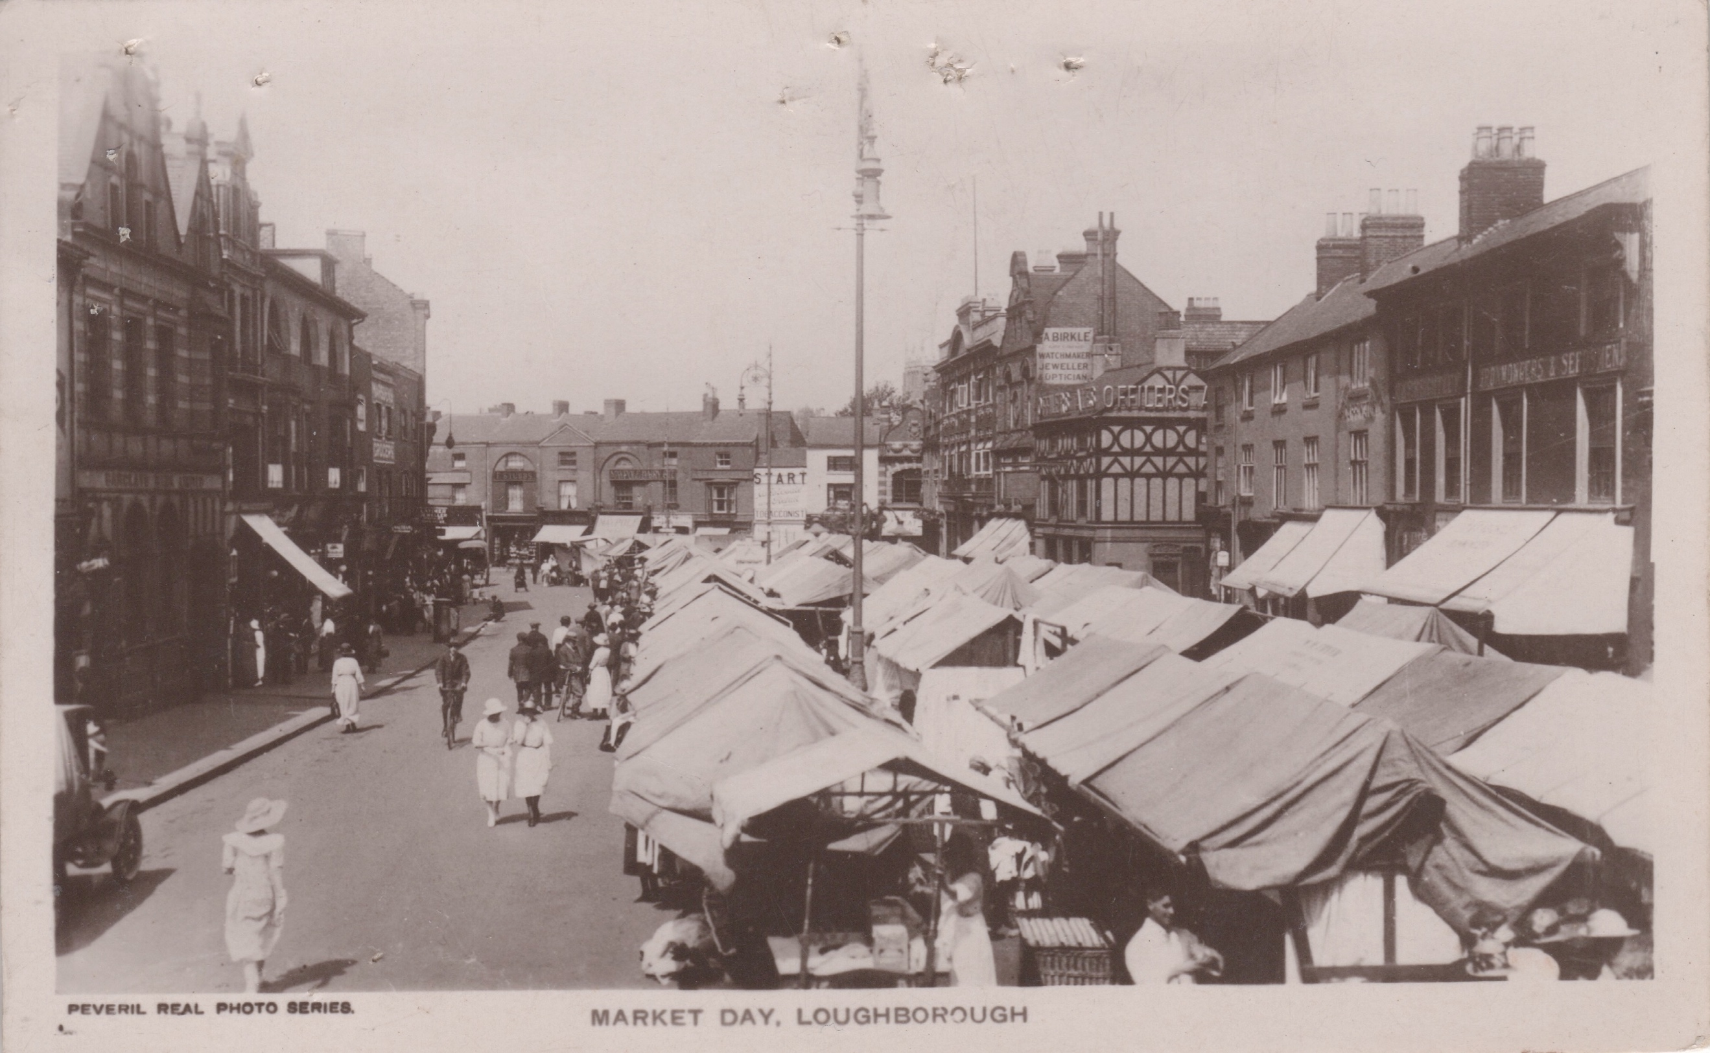

Slide 15
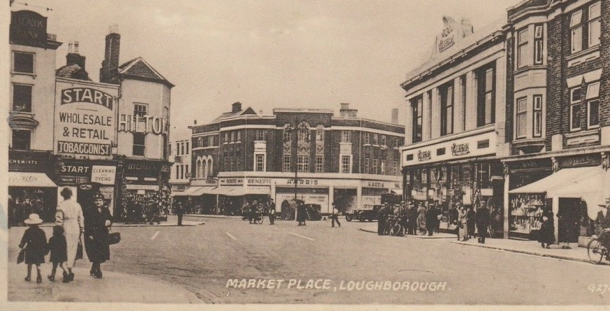

Slide 16
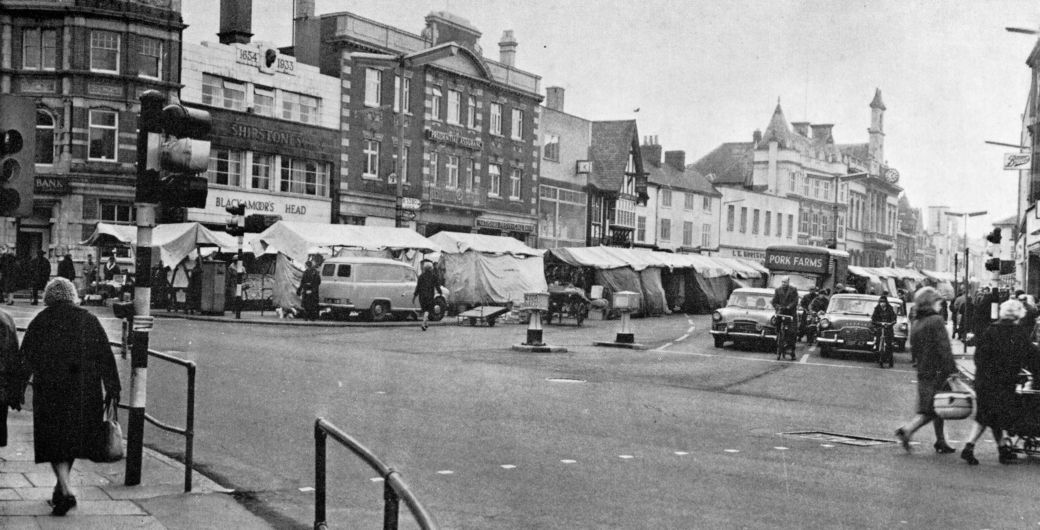

Slide 17
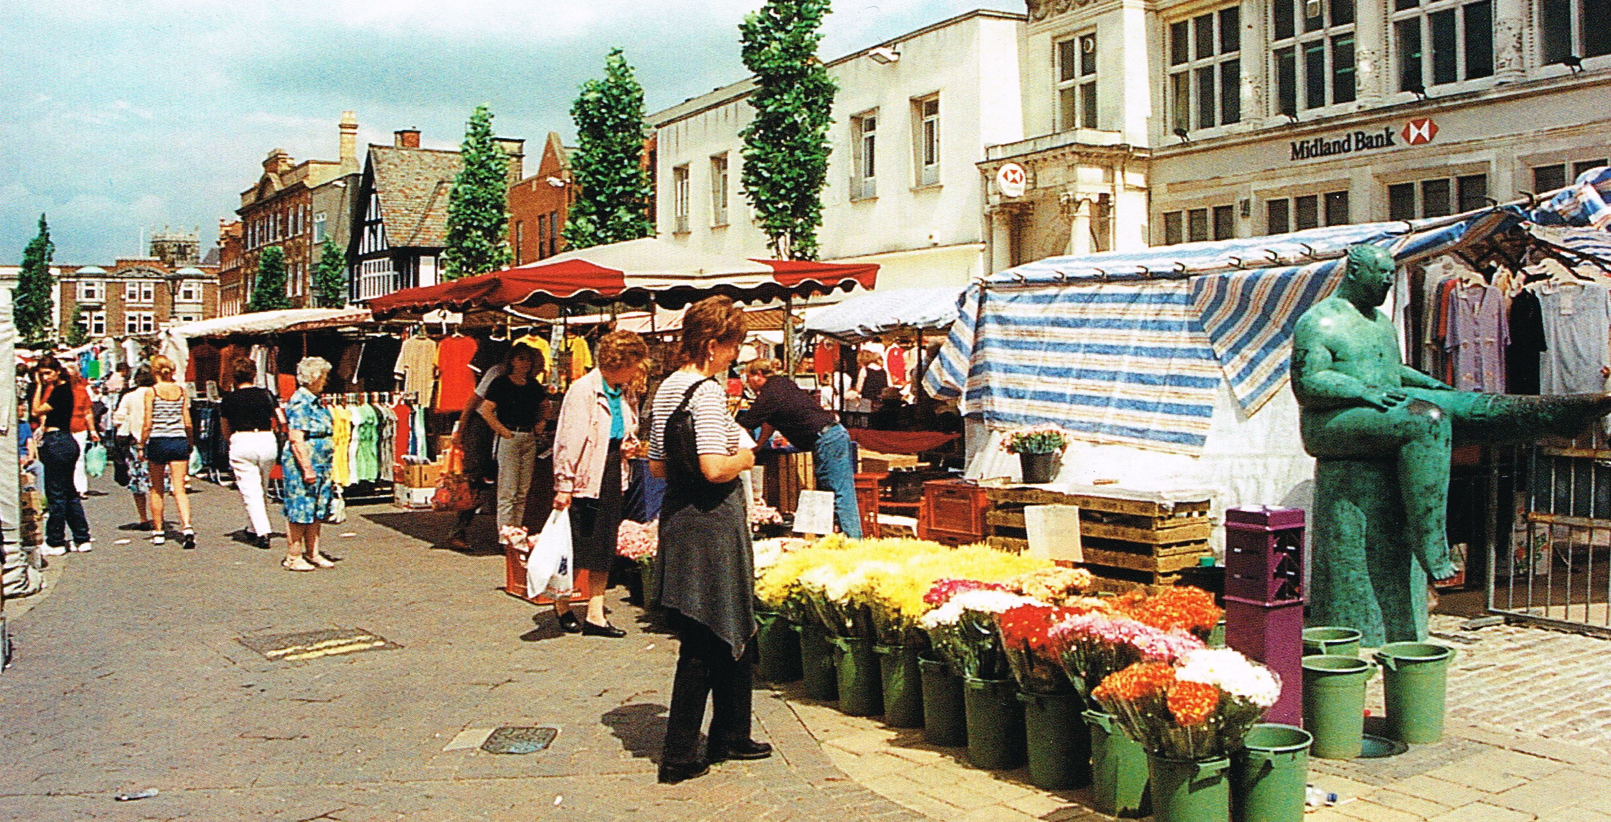

Slide 18
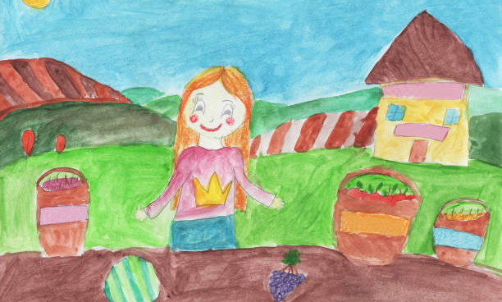
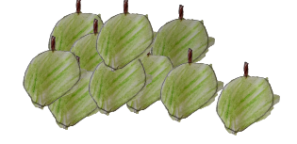
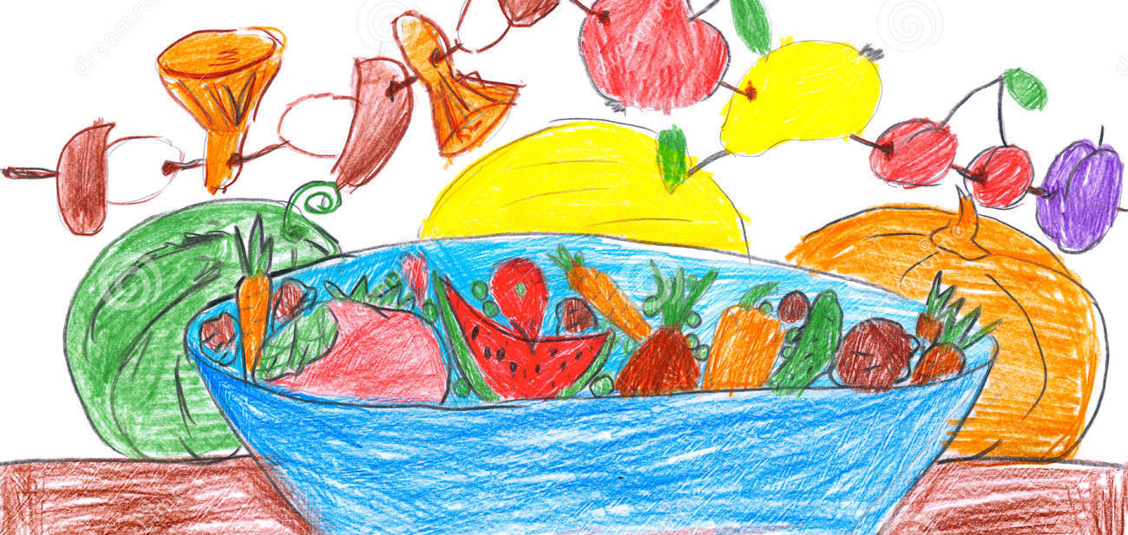
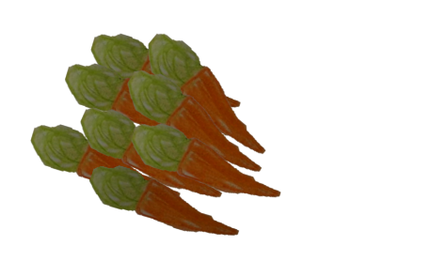

Slide 19
Further Events you can visit with family and friends this year.
Our Market, Our Fair, Loughborough Town Hall Exhibition will be on display from 14th October - 18th November 2021
Our Market, Our Fair, Charnwood Museum Exhibition will be on display from 10th July – 18th December 2021

