Slide 1
Strategy development amid organisational change
Beth Bryan
Audience Strategy Lead, Barbican Futures Planning Officer
Chair of the Visitor Studies Group

Slide 2
Developing our strategy
Intent and development process
Assess where we are now
Identify where we want to be
Map the gap
Identify dependencies, challenges and advocates
2

Slide 4
Intent and development process
Intentionally long development period
Enable the organisational framework to develop in tandem
Met our current resources and capacity needs
Secured better buy-in
Employ objectivity, collaboration & transparency
Root change in the why
Use tools and practices based on objectivity, best practice and expertise
Curiosity and support not judgement
4

Slide 5
Intent and development process
Reject silos
Strategy cannot be achieved alone
Challenges are not unique
5

Slide 6
Competencies Framework
External: Data & Insights drive the audience voice across the organisation
Internal: Leadership ensures prioritisation
Data & Insights | Storytelling | Service Delivery | Leadership | Culture | Operating Model
Diversity monitoring | Brand & tone of voice | Product | Commitment | Reflection, evaluation & learning | Capacity
Experience & feedback | Integrated campaign development | Excellent welcome & experience | Accountability | Cyclical & dynamic programming | Capability
Potential/ target audience research | Media relations | Accessibility & inclusion | Learning & development | Collaboration & communication | Resources
Behavioural data | Above the line marketing | Information & support | Role modelling behaviour | ‘Audience first’ approach | Organisational structure
Processing & storage | Digital | Digital experience |  | Embodying values | Engagement journey
Benchmarking | CRM marketing | Management & maintenance |  |  | Partnerships
Access & transparency |  | Audience safety
Dissemination & action
6

Slide 7
Maturity Model
2023
1. Recording | 2. Reactive | 3. Strategic | 4. Optimise
You know who we are | You know what we want | You work with us to achieve strategic goals | We are at the heart of everything you do
You monitor who we are & our experiences | We provide feedback & you act on this | Feedback is encouraged to improve offer & experience | We are prioritised & co-create changes with you
Our experience is transactional | You generate insights from audience data | We know your purpose and strategic aims and where we fit into this | New audiences can be engaged while maintaining us
You record this information & report ad hoc | Audience data is used to demonstrate success & considered in decision-making | You act collectively based on audiences; information is accessible & transparent | We are at the heart of every decision – on an individual, team & organisational level
 |  | Leadership has accountability for implementing changes | Your leadership values us & shares power with us
 |  |  | Audience is everyone’s business
The organisation holds sufficient data centrally on audiences with measures in place to reduce gaps in knowledge. | The organisation has central capability and resources dedicated to systematically monitor audience feedback and prioritises changing to target audience needs. | The organisation has an Audience Strategy that all departments work towards, with clear aims, targets and measures. | Everyone in the organisation understands the importance of audiences and ensures everything they do has a positive impact on audiences.
7

Slide 8
Where do we want to be?
Address knowledge gaps
Know who our audiences are, their experiences and desires
Establish baseline, then set targets
Address audience gaps
Retain existing audiences
Not a zero sum game
We cannot be everything to everyone at all times, but we can meet the needs and expectations of both our target and current audiences in our programme.
8

Slide 9
Maturity Model
2023
2026
1. Recording | 2. Reactive | 3. Strategic | 4. Optimise
You know who we are | You know what we want | You work with us to achieve strategic goals | We are at the heart of everything you do
You monitor who we are & our experiences | We provide feedback & you act on this | Feedback is encouraged to improve offer & experience | We are prioritised & co-create changes with you
Our experience is transactional | You generate insights from audience data | We know your purpose and strategic aims and where we fit into this | New audiences can be engaged while maintaining us
You record this information & report ad hoc | Audience data is used to demonstrate success & considered in decision-making | You act collectively based on audiences; information is accessible & transparent | We are at the heart of every decision – on an individual, team & organisational level
 |  | Leadership has accountability for implementing changes | Your leadership values us & shares power with us
 |  |  | Audience is everyone’s business
The organisation holds sufficient data centrally on audiences with measures in place to reduce gaps in knowledge. | The organisation has central capability and resources dedicated to systematically monitor audience feedback and prioritises changing to target audience needs. | The organisation has an Audience Strategy that all departments work towards, with clear aims, targets and measures. | Everyone in the organisation understands the importance of audiences and ensures everything they do has a positive impact on audiences.
9

Slide 10
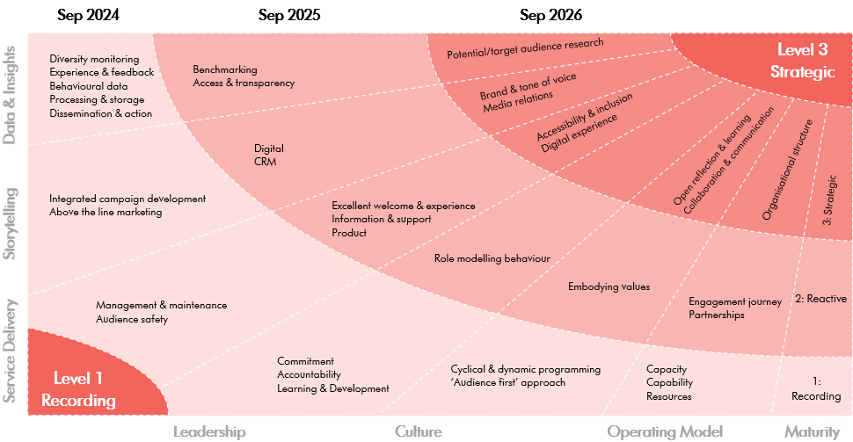
Three-year transformation 2023 - 2026
10

Slide 11
How will we get there?
Values-led, data-informed decision-making:
Sustainable – Redefine value, change metrics
Inclusive – Work with and for audiences
Connected – Build relationships
Joyful – Deliver positive experiences
Daring – be relevant and civically engaged
11

Slide 12
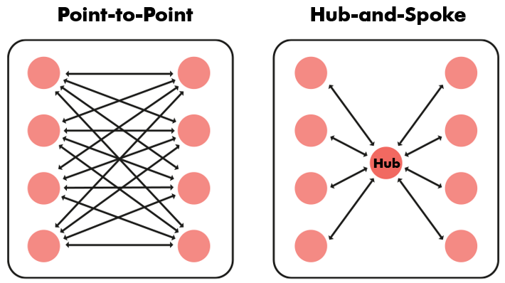
Connected – Build relationships internally
Collaborating and breaking down siloes will enable us to work more efficiently and effectively for our audiences. Currently a Point-to-Point model is used to share audience data – it is collected, held, shared and actioned upon largely in siloes.
Shifting to a Hub-and-Spoke model where data is centralised, accessible and transparent across the organisation will create a central point of truth, reduce inefficiencies and improve response time to address issues raised by our audiences.
12

Slide 13
Dependencies & challenges
Dependencies
Cannot just be one part of the organisation
Consider organisational structure and reallocation of resources
Challenges
Myths that are hindering our cultural change and delivery:
Diverse artists are the only way to engage diverse audiences
If successful, it is good programming; if not, it is bad marketing
Data and art don’t go together
We wouldn’t have difficulties increasing and diversifying our audiences if we could make every show free
13

Slide 14
Advocates
Audience advocates
Desire to run before we can walk
Careful expectation management
Will enable the delivery of the strategy
14

Slide 15
Beth Bryan
BethBryanConsultancy@gmail.com
Visitor Studies Group
https://visitors.org.uk/
the.visitor.studies.group@gmail.com

