Slide 1

Visioning an audience data strategy;
A symposium of creative approaches
Notes:
Philip

Slide 2

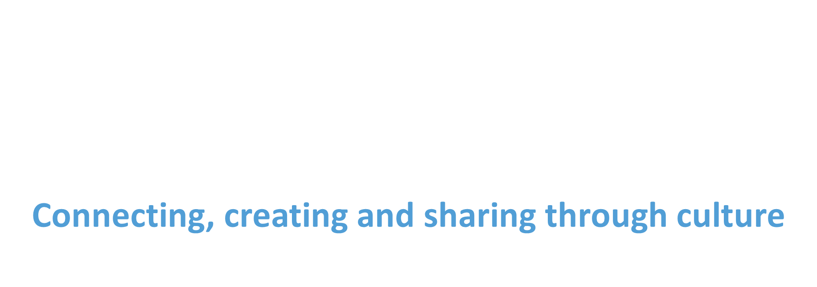

Slide 3
Before we get started
Today’s Symposium is scheduled to last 150 minutes / 2.5 hours.
There will be a break of 10 minutes at 11am
Closed captions should be available by clicking on ‘more’, selecting language and speech and ‘turn on live captions’
Camera on/off - your choice
Please keep your microphone muted unless you are invited to pose your question during the Q&A
We will be recording the event and we will share it with all attendees alongside the slides and short evaluation within 7 days
Please save your questions for the Q&A session
Notes:
Philip

Slide 5
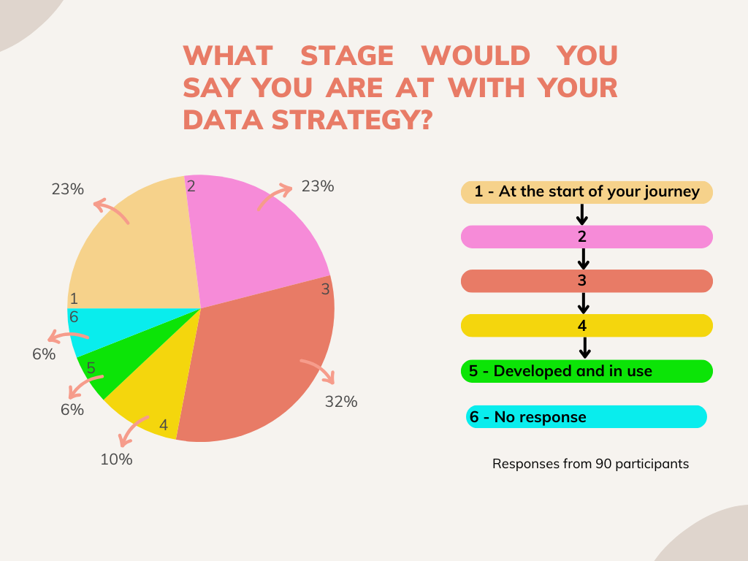

Slide 6
Visioning a Creative and Cultural County: Developing Leicestershire County Council’s Cultural Strategy (VCCC)
❖ University of Nottingham (UoN) and Leicestershire County Council (LCC) Partnership — Visioning a Creative and Cultural County: Developing Leicestershire County Council’s Cultural Strategy (VCCC) — January 2023-March 2024.
❖ Project Team: Amanda Hanton, Cat Rogers, Franne Wills, Sam Berry and Helen Harris (LCC), Dr Sophie Frost (University for the Creative Arts) and Daniel Mutibwa (UoN).
❖ Joining up and/or strategically aligning LCC cultural services.
    auditing current cultural services to identify existing alignment, duplication and shared outcomes.
    consulting a wide range of stakeholders on how they would like to see cultural services designed and how those services could be made meaningful to them in a sustainable way.
    learning from good-practice, strategic models underpinning delivery of cultural services at selected county/district councils nationally.
❖ Online Cultural Strategy Symposium (25th April 2023) — Fenland, Derbyshire and Kent.
❖ Valuable learning from the Online Cultural Strategy Symposium inspired the organisation of this event.

Slide 7




https://www.cultureleicestershire.co.uk
www.facebook.com/CultureLeics www.twitter.com/CultureLeics www.instagram.com/cultureleics

