Slide 1
Museum Collections and Sense of Place
Alison Clague
Senior Curator
Leicestershire Museum Collections

Slide 2
Museums and their collections can reinforce and influence our sense of place
But…
Whose place?
Who gets to decide?
How can we reflect changing places and incorporate new voices?
Notes:
– is this always a good thing?
Responsibility not to force the narrative

Slide 3
Our collecting policy
To collect and record the natural life of the County of Leicestershire and to reflect the histories, interests and aspirations of the people who have made it their home and place of work.

Slide 4
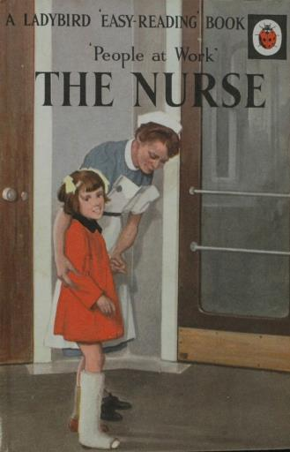
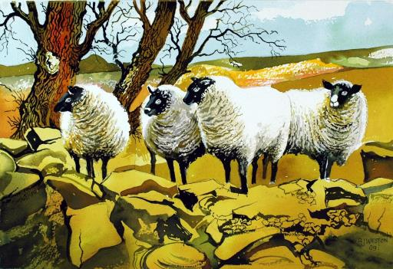
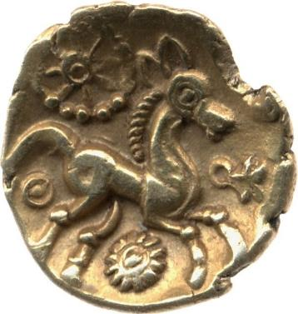
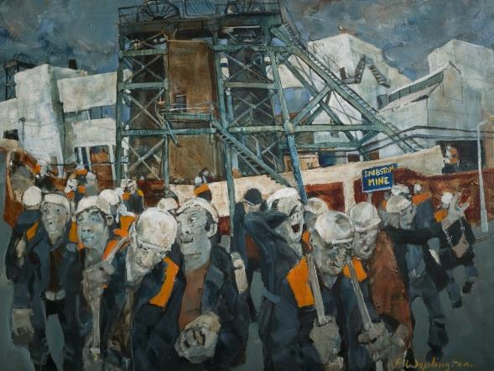
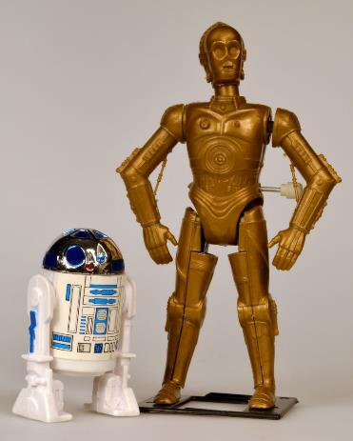
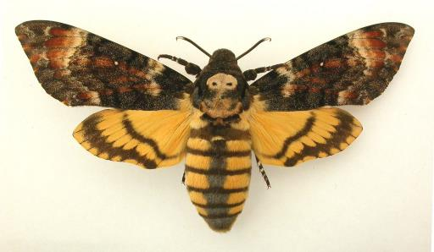
Is this reflected in our actual collections?

Slide 5
What are our challenges?
Resources
Collections that don’t seem relevant to our communities
Expertise
Data
Connections to communities
Notes:
Curatorial bias
Privilege of being able to donate
Who is using our collections and why?
What is important now?

Slide 6
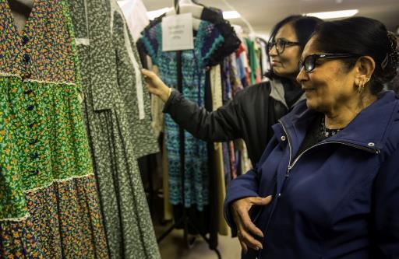
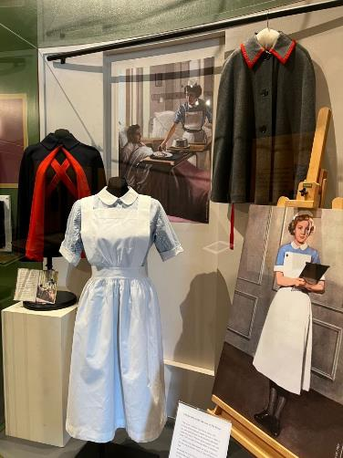
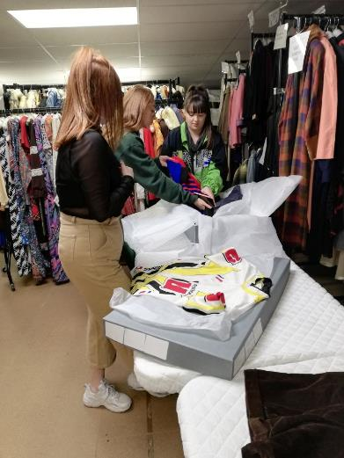
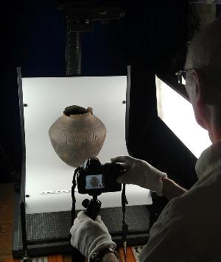
How can we address this?
Being honest about the gaps in our collections and knowledge
Letting go of curatorial authority
Helping people find and tell their own stories using our resources
Updating policies – but act on them!
Being proactive
Working with communities with equity
Being creative with existing collections
Thinking about how we record objects on our collections management system
Acknowledging that we can’t do it all

Slide 7
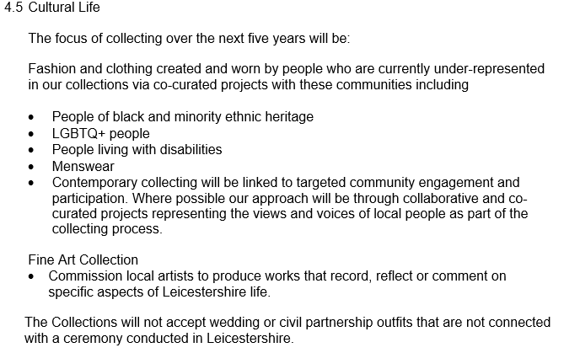
What we are doing
Our Collections Development Policy 2021-2025

Slide 8
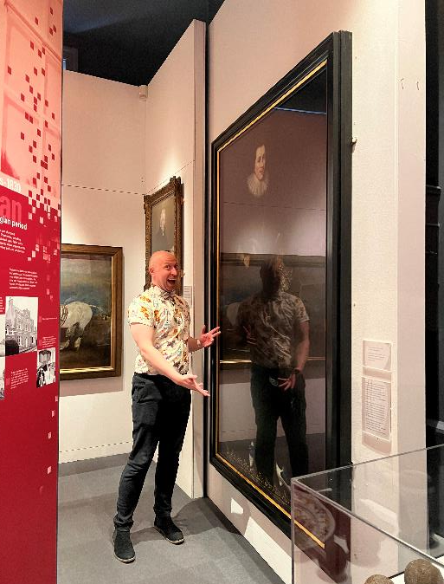
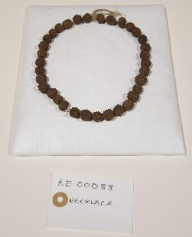
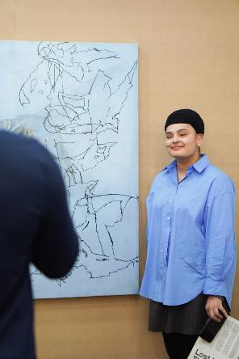
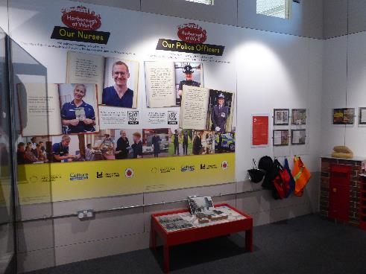
How are we putting it into action and what have we achieved?
Working with colleagues in Participation and Heritage teams
Enriching collections knowledge and interpretation
Giving space for new voices and approaches
Commissioning research
Notes:
Enriching collections knowledge
Looking at things in new ways
Attracting new audiences and engagement
Refreshing displays and interpretation
New voices

Slide 9
Find out more
https://leicestershirecollections.org.uk/
@leicestershire_collections
alison.clague@leics.gov.uk

