Slide 1



Sense of Place
People and Stories
Philip Warren, Collections and Learning Manager &
Alison Clague, Senior Curator

Slide 2
What are we going to be doing today?
09.30 Welcome and Introductions
10.00 What are we going to do today?
10.05 A sense of Place – People and Stories
10.30 BREAK
10.40 Case Studies
11.25 BREAK
11.35 Workshop Introduction
11.40 Workshop
12.00 Feedback
12.20 Closing Remarks and Takeaways

Slide 3
Welcome and Introductions
Who are you and where are you from?
Tell us one surprising thing about your place
What do you hope to get out of this session?

Slide 4














Slide 5
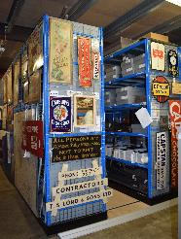
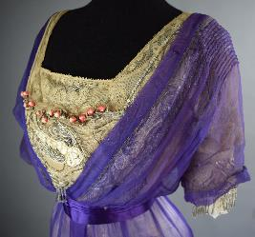
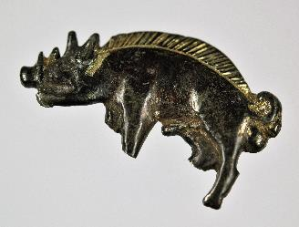
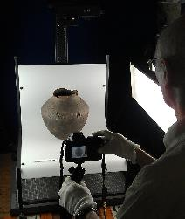
People and Stories
Who we are
What we do
How Museum Collections fit within Culture Leicestershire

Slide 6
Our collecting policy
To collect and record the natural life of the County of Leicestershire and to reflect the histories, interests and aspirations of the people who have made it their home and place of work.

Slide 7
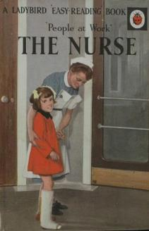
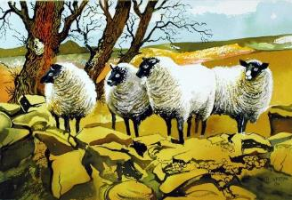
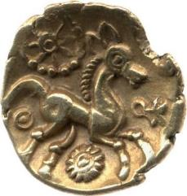
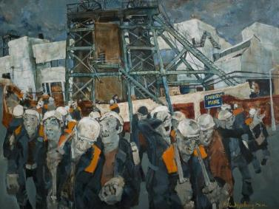
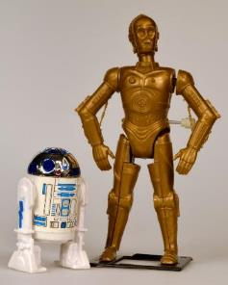
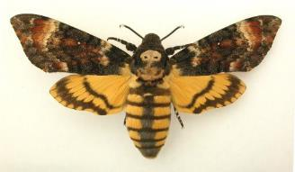
Is this reflected in our actual collections?

Slide 8
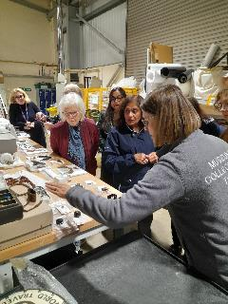
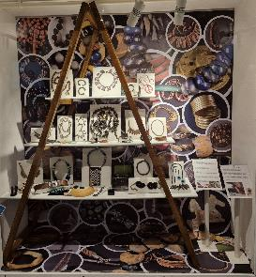
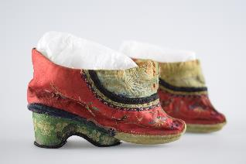
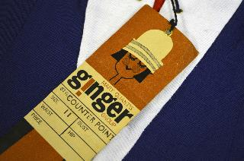
Some collections have a less obvious link
Mass-produced objects
Fashion
World Cultures
Things collected in the past that would not fit our current collecting policy

Slide 9
Museums and their collections can reinforce and influence our sense of place
But…
Whose place?
Who gets to decide?
How can we reflect changing places and include new voices?
Notes:
– is this always a good thing?
Responsibility not to force the narrative

Slide 10
Who is missing?
How do we know – do we have the data?
How can we find out?
Invite new perspectives
Research and consultation
Recognise and challenge unconscious and conscious bias

Slide 11
What are the challenges?
Resources
Collections that don’t seem relevant to our communities
Expertise
Data
Connecting to local communities
Notes:
Curatorial bias
Privilege of being able to donate
Who is using our collections and why?
What is important now?

Slide 12
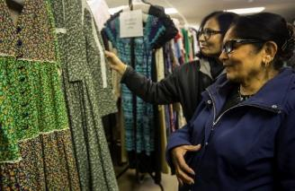
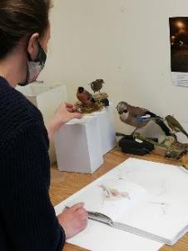
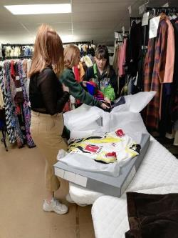
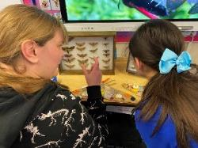
How can we address this?
Being honest about the gaps in our collections and knowledge
Letting go of curatorial authority
Helping people find and tell their own stories using our resources
Updating policies and acting on them
Being proactive
Working with communities with equity
Being creative with existing collections
Thinking about how we record objects on our collections management system
Acknowledging that we can’t do it all

Slide 13
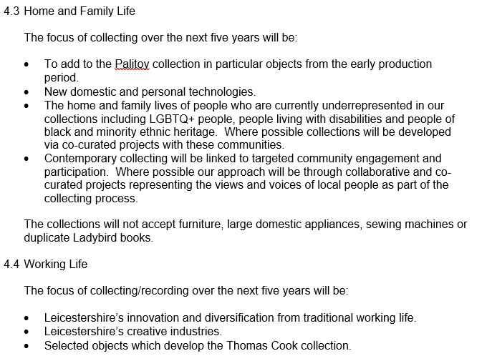
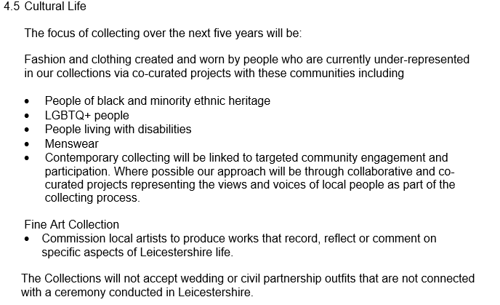
What we are doing
Our Collections Development Policy 2021-2025

Slide 14
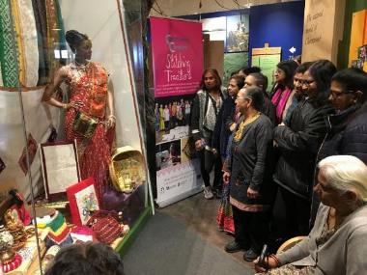
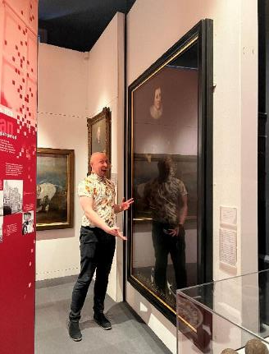
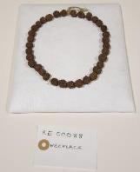
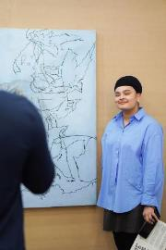
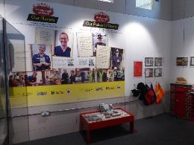
How are we putting it into action and what have we achieved?
Working with colleagues in Participation and Heritage teams
Enriching collections knowledge and interpretation
Giving space for new voices and approaches
Commissioning research
Notes:
Enriching collections knowledge
Looking at things in new ways
Attracting new audiences and engagement
Refreshing displays and interpretation
New voices

Slide 15
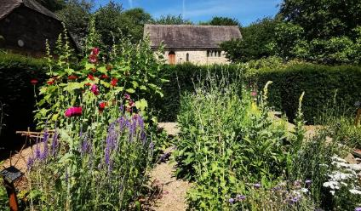
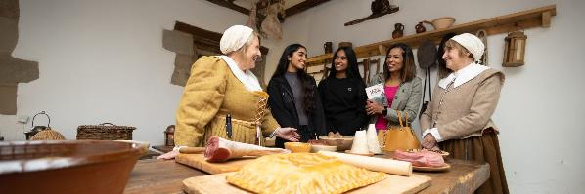
Friends Welcome at the
1620s House & Garden
An initiative to bring more isolated members of our community together
We provide tea, coffee, soup and a chat with our friendly team
Different activities every week
It is supported by Hugglescote and Donington Parish Council

Slide 16

Digital and social media
https://leicestershirecollections.org.uk/
@leicestershire_collections
Heritage & Museums | Culture Leicestershire - Heritage, Libraries, Collections and Learning

Slide 17
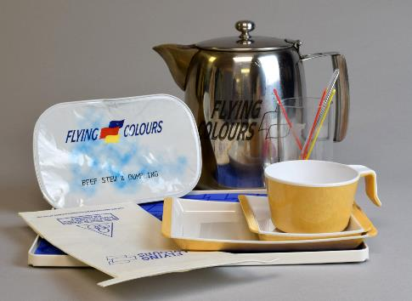
Break
Please be back in 10 minutes

Slide 18
Case Studies
People and Collecting: The Millennium Collection
Engaging with Collections and Museum Spaces: Stitching Traditions
Connecting People through Objects and Stories: Villiers Revealed

Slide 19
The Millennium Collection
The last major collecting project that the Museum Service did
Funded by a Grant from the Millennium Commission and the National Lottery
Involved families, community groups, local businesses, faith groups, charities, schools, clubs and societies and organisations like the NHS
Choose and donate an object which they felt was important to them
Twenty-Five Years On - (a generation!) - we are revisiting the Millennium Collection in an exhibition at Melton Carnegie Museum.

Slide 20
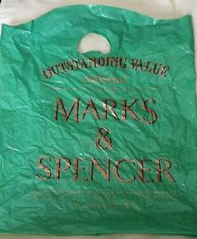
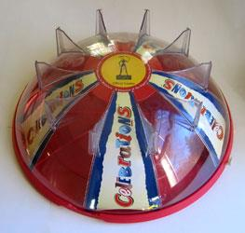
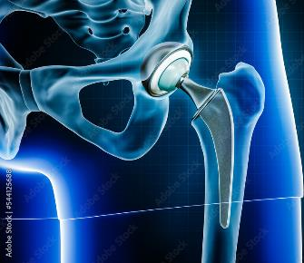
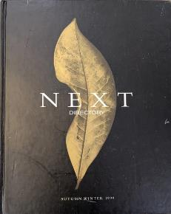
The Millennium Collection
The ordinary becomes extraordinary

Slide 21
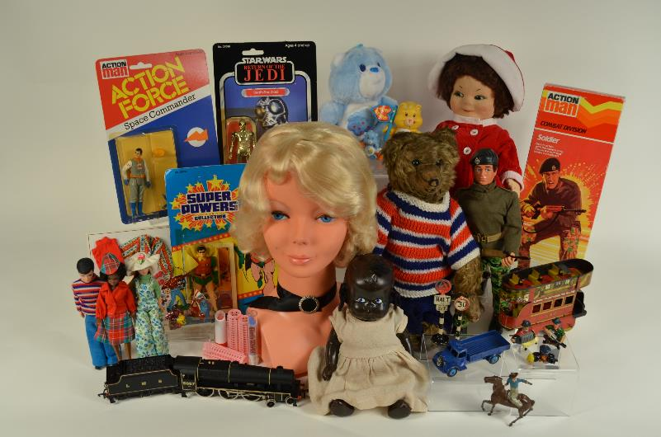
Next steps – Young People and Collecting

Slide 22
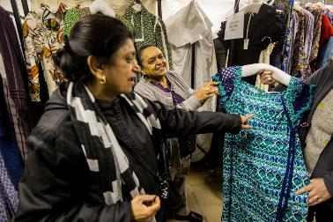
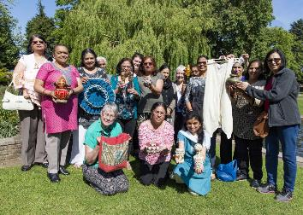
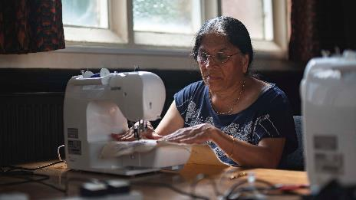
Stitching Traditions

Slide 23
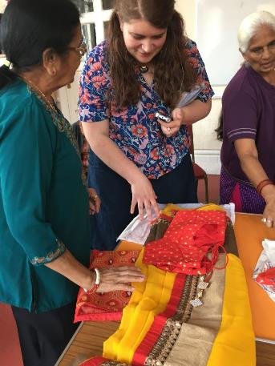
Stitching Traditions
A partnership project
Migrant Memory and the Postcolonial Imagination, Loughborough University
Linked with the Anand Mangal Ladies Group
Where would it take us?

Slide 24
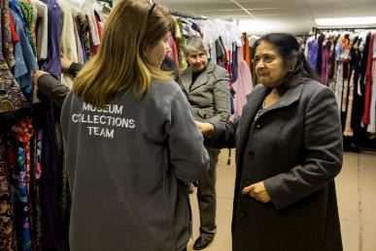
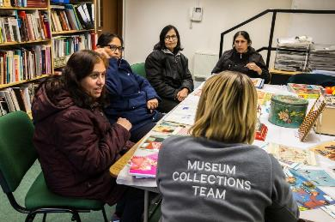
Stitching Traditions
Co-production/co-curation approach
Visit to Collections Resources Centre
Workshop on how to use objects to tell your story
How to display and interpret objects
Visit to Belgrave Road

Slide 25
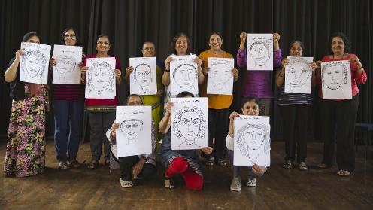
Stitching Stories
Textiles and crafting important part of the ladies’ culture
Stitching workshop at Fearon Hall with a performance textile artist
Using sewing machines brought back memories of work and home life
Singing, reminiscence, sharing stories
Ladies brought in objects they had made at home, important family textiles (e.g. wedding saris) or made in during their work at factory in Loughborough

Slide 26

Creating a display
Ladies brought in their treasured objects, many of which were hand-crafted
Created a display at Charnwood Museum with support from Collections Team
Worked with University to collect information about the objects for the labels
Some of the items were later donated to the museum collections

Slide 27
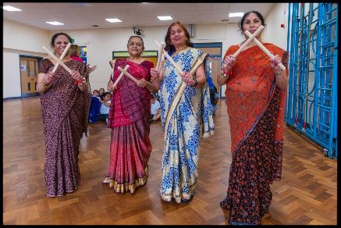
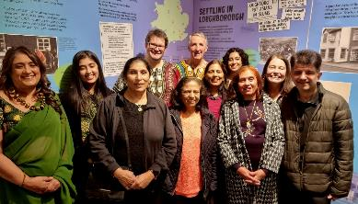
Continuing the thread
Ladies put on a fashion show of saris at Loughborough Mela
Created booklet to go with fashion show
Worked with Creative Learning Services to develop and deliver a schools’ learning programme
Went on Bargain Hunt!
Worked with us on Uganda 50 and My Jewellery, My Story exhibitions
Performed at Culture Leicestershire events
Part of our Community Connectors group

Slide 28
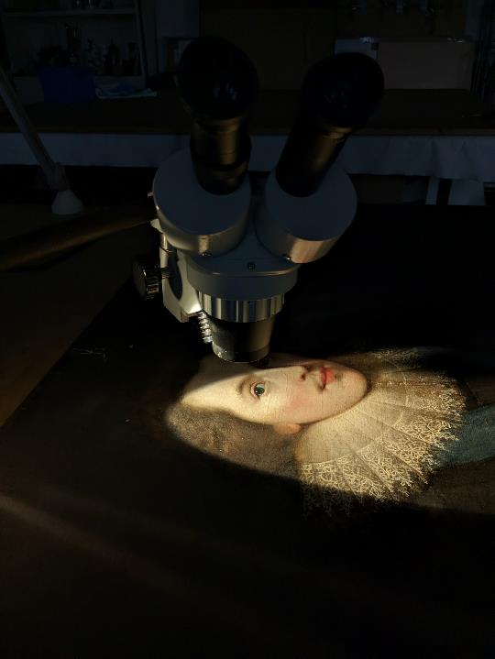

Villiers Revealed
The Darling of the Stuart Court
Exploring LGBTQ+ connections in
Leicestershire’s museum collections

Slide 29
Why now?
Priority identified in our Collections Development Policy
Arts Council England NPO funding
Part of our commitment to equality, diversity and inclusion
Painting identified during Jon Sleigh’s survey of our collections

Slide 30
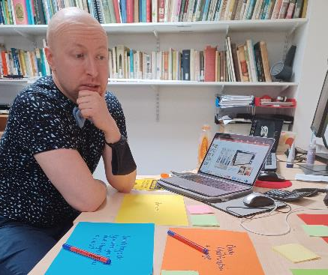
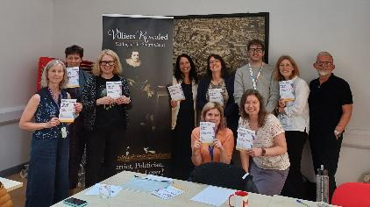
Our approach
Researched best practice
Commissioned Jon Sleigh to survey our collections and give us recommendations
Based on this, developed a safe framework for future work
Identified appropriate training for staff and volunteers

Slide 31
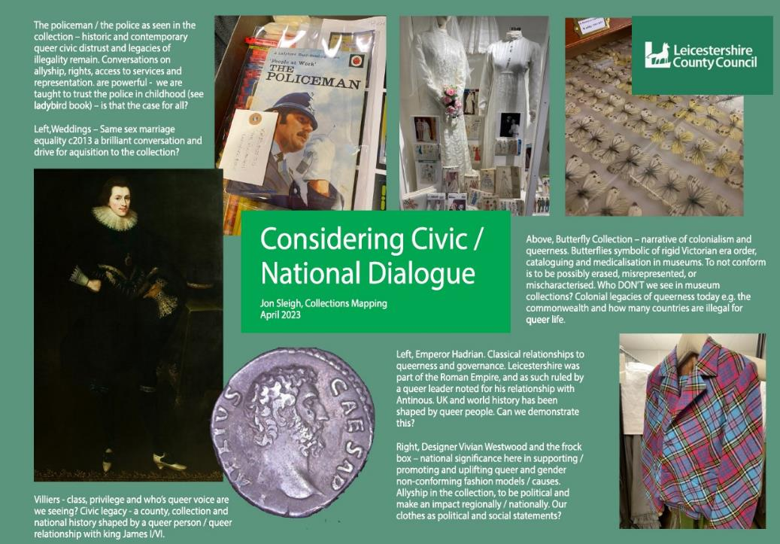

Slide 32
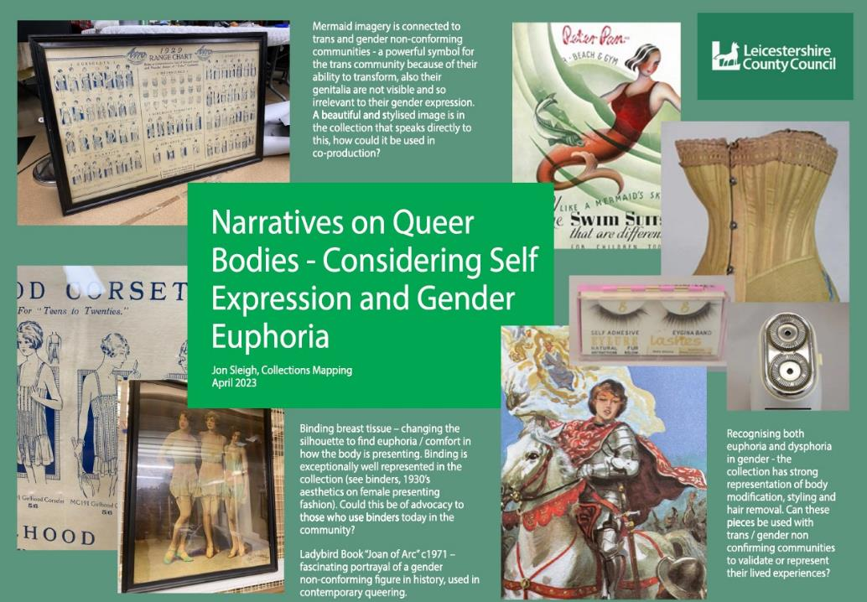

Slide 33
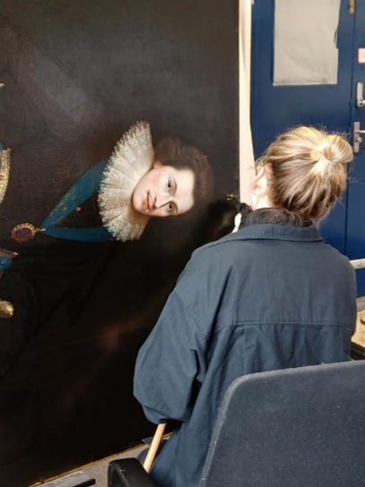
Why Villiers?
Direct link to Leicestershire
Born at Brooksby Hall in 1592
Was the ‘favourite’ of King James I
One of the most famous LGBTQ+ stories in British history
An opportunity for new research and interpretation

Slide 34
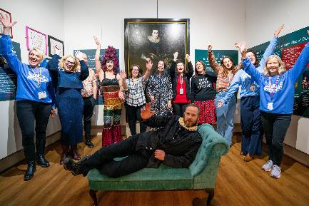
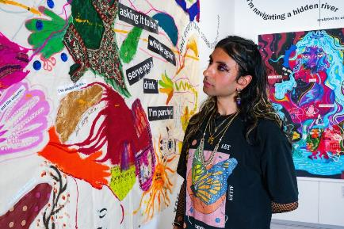
What was the result?
Two exhibitions at Melton Carnegie Museums
Engagement with new audiences
Improvements to our offer
Increased staff confidence to continue this work
Villiers Revealed Digital Exhibition

Slide 35


Villiers Revealed – We have always been here
Challenge to colonial binary
Community and multiplicity
New audiences and voices adding to the story

Slide 36


What we learned
Creative practitioner was key to engaging with LGBTQIA+ groups
Launch events made us see our museum spaces in new ways
Being prepared for challenge
That we can look at our collections in new ways

Slide 37

Break
Please be back in 10 minutes

Slide 38
Workshop
Group 1
Bassetlaw Museum, Rugby Museum & Art Gallery, The Almonry Museum
What out of your collections or your building do you think you could make more of when developing connections between people and stories?
What Resources would you need to be able to do this?

Slide 39
Workshop
Group 2
The Pen Museum and Shakespeare’s Birthplace Trust
Who or what is missing from your collections?
What resources would you need to start to address this?

Slide 40
Workshop
Group 3
Selly Manor and Tamworth Castle
What or whose stories might be hidden in your collections or building?
What resources would you need to start to uncover them?

Slide 41

Feedback

Slide 42
What will you take away?

