Slide 1
Create space to spark imagination, celebrate communities and enhance wellbeing

Slide 2
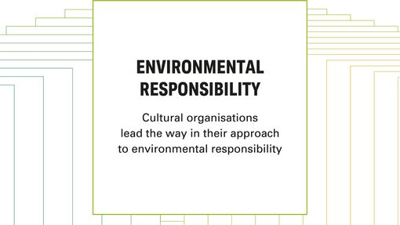
Source: https://www.artscouncil.org.uk/lets-create/strategy-2020-2030/investment-principles

Slide 3
12 Month Ambition
Recruit more green champions
Share environmentally friendly practices
Celebrate and share the impact of change
Support stakeholders to embed environmental concerns within their work

Slide 4
3 Year Ambition
The Council has declared it’s intention to be net zero by 2030
Embed Environment and Net Zero strategies into our operating model
Ensure staff, creative practioners, participants, and volunteers are enabled to make their contribution

Slide 5
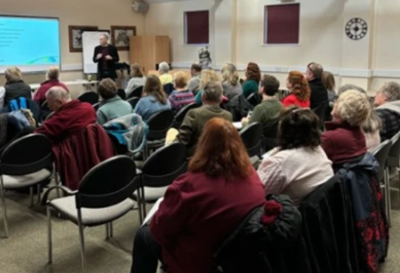
Bosworth Bring & Take Event
What we’re doing as a department
Heritage & Museums Environmental Training
Net Zero Workshops held across Libraries

Slide 6
Recycling

Slide 7
LCC Actions
Comms Environment Bulletin
Intranet Posts e.g. recent post on sensitive re-gifting
Sustainable Travel Roadshows
Environmental Audits
What we’re doing as a Council

Slide 8
Green Champions

Slide 9
Resources
https://www.cultureleicestershire.co.uk/about-us/cultural-services/

